Slide 1
Main Results - Previous Years of Tourism
A lot of previous Years of Tourism have not been bilateral, although they claimed to be
Many activities did not target tourists directly, instead tour operators, media and policy
Activities, which would have been done anyway, have been done under the umbrella of YoT

Slide 2
Main Results - Previous Years of Tourism
Focus on cultural events (e.g. opera, ballet, concerts)
Mainly classical advertisement, social media was seldom used
Results are not published and communicated
Controlling and measurement of the success is complex

Slide 3
Main Results - Current Years of Tourism
Shift from leisure tourism to targeting all kinds of tourism, including business, MICE, investment, sport, etc.
Rather limited shift to using social media
Lack of marketing campaigns for YoT (except China-Australia YoT 2017)
Using tourism as a window to develop other fields

Slide 4
Logos for previous and current YoT's
China-India Tourism Year 2016
China-USA Tourism Year 2016
China-Denmark Tourism Year 2017
2017 China-ASEAN Year of Tourism Cooperation
China-Australia Year of Tourism 2017

Slide 5
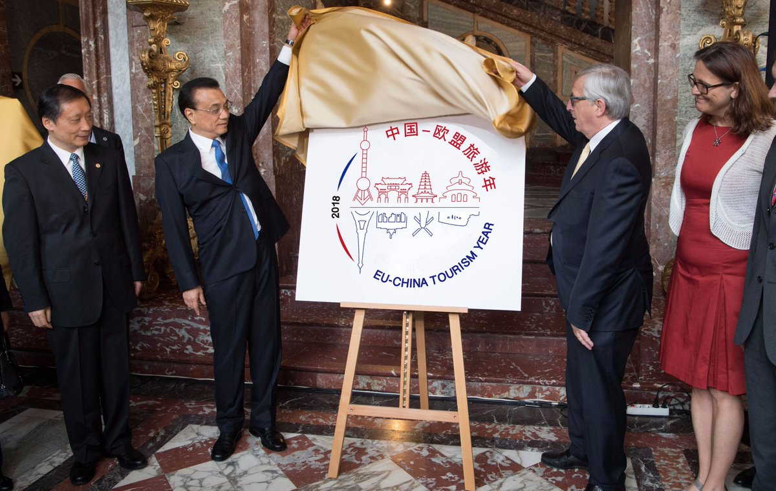
Logo of EU-China YoT 2018 (Chinese version)

Slide 6
Our Recommendations for EU-China YoT 2018

Slide 7
Our Recommendations for EU-China YoT 2018:
Establishing Directorate-General for tourism in EU
Develop organizational structure of EU-China YoT 2018 with the participation of representatives from both sides
Increase knowledge & human resources about Chinese Culture
Support more Chinese friendly websites & tools
Promote less popular destinations (starting with the logo)

Slide 8
Our Recommendations for EU-China YoT 2018:
Make establishing YoT 2018 visible for travellers (creating welcoming desks at the airports, QR-codes providing information about places to visit both in Europe and China)
Apply the idea of China-Australia YoT 2017: “Panda Vans” for China-EU YoT 2018 (use Euro vans going across China, promoting Europe, using Chinese vans going across Europe, promoting China)

