Slide 1



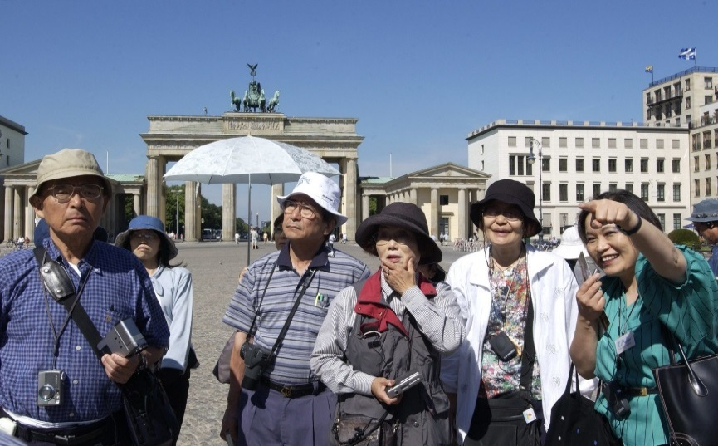

Slide 2
Wealth Distribution in China 2019
Class | Spending amount per day (PPP) | Percentage and total number of population China | In Comparison: Percentage and total number of population India | In Comparison: Percentage and total number of population Thailand
High | More than 50 USD | 0.8% 11,200,000 | 0.1% 1,340,000 | 2.1% 1,449,000
Upper-middle | 20-50 USD | 9.7% 135,800,00 | 0.6% 8,040,000 | 19.0 % 13,110,000
Lower-middle | 10-20 USD | 29.0% 406,000,000 | 2.6% 34,840,000 | 40.1% 27.669,000
Low | 2-10 USD | 59.6% 834,400,000 | 72.2% 967,480,000 | 38.8% 26,772,000
Poor | Less than 2 USD | 0.9% 12,600,000 | 24.5% 328,300,000 | 0.03% 20,700

Slide 3
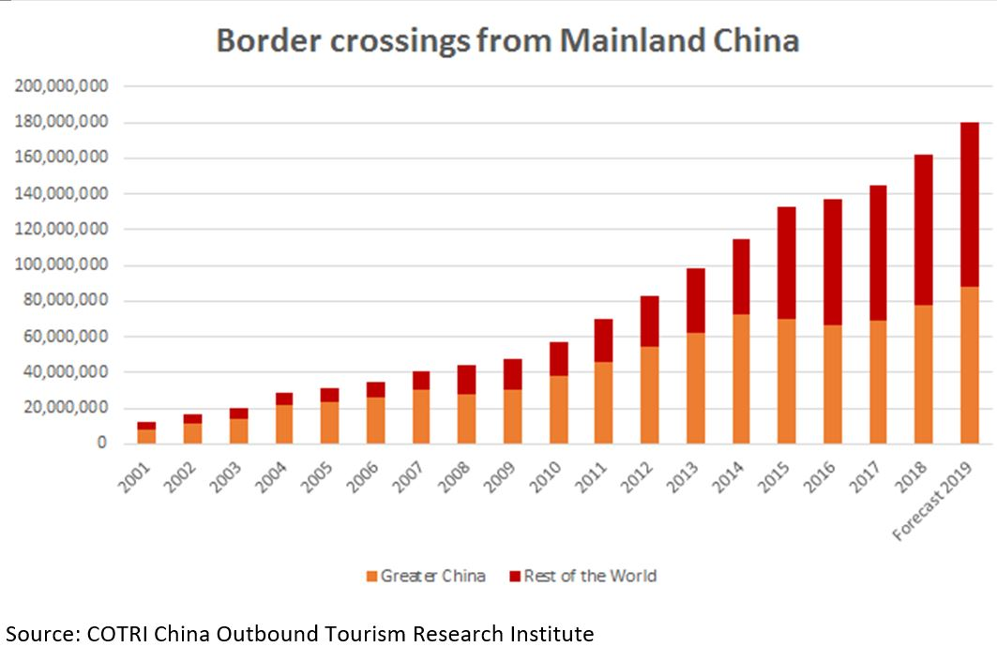
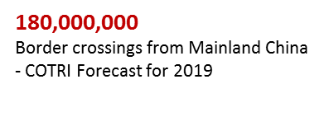
China’s Outbound Tourism 2001-2019

Slide 4
China’s Outbound Tourism 2019-2030 (COTRI Forecast)

Slide 5

Top 15 Most Visited Destinations 2011-2018
 | 2011 | 2012 | 2013 | 2014 | 2015 | 2016 | 2017 | 2018
1 | Hong Kong | Hong Kong | Hong Kong | Hong Kong | Hong Kong | Hong Kong | Hong Kong | Hong Kong
2 | Macau | Macau | Macau | Macau | Macau | Macau | Macau | Macau
3 | South Korea | South Korea | Thailand | South Korea | Thailand | Thailand | Thailand | Thailand
4 | Taiwan | Thailand | South Korea | Thailand | South Korea | South Korea | Japan | Japan
5 | Thailand | Taiwan | Taiwan | Taiwan | Japan | Japan | South Korea | Vietnam
6 | Singapore | Singapore | Singapore | Japan | Taiwan | Taiwan | Vietnam | South Korea
7 | Vietnam | Malaysia | Vietnam | USA | USA | USA | USA | Singapore
8 | Malaysia | USA | USA | Vietnam | France | Singapore | Singapore | USA
9 | France | Japan | Malaysia | France | Italy | Vietnam | Italy | Malaysia
10 | USA | Vietnam | France | Singapore | Singapore | Malaysia | Taiwan | Taiwan
11 | Japan | France | Japan | Malaysia | Vietnam | Italy | Malaysia | Italy
12 | Italy | Italy | Italy | Italy | Malaysia | France | France | France
13 | Germany | Russia | Russia | Russia | Germany | Indonesia | Indonesia | Indonesia
14 | Indonesia | Germany | Germany | Germany | Indonesia | Germany | Germany | Cambodia
15 | Australia | Indonesia | Indonesia | Indonesia | Switzerland | Russia | Russia | Russia
www.china-outbound.com

Slide 6
2018 Spending per trip USD 1,700
Source: COTRI ANALYTICS
UNWTO Tourism Highlights 2011-2018
www.china-outbound.com

Slide 7






Eight Trends in Chinese outbound tourism 2019

Slide 8

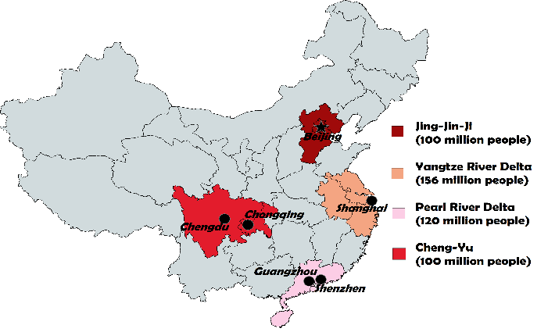
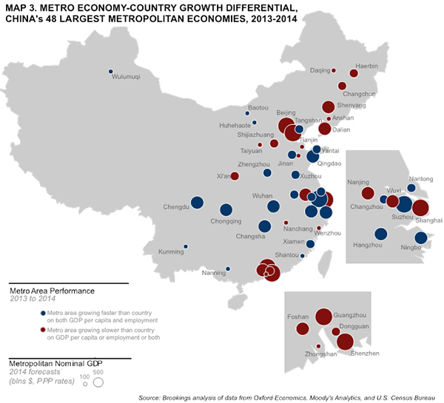
TREND 1: Further segmentation of Chinese outbound tourism source market
Today no more than 10% of Chinese citizens possess passports
Almost all live in 1st and 2nd tier cities
Until Now Only Four Economic Regions As
Main Tourist Source Regions
The vast majority of Chinese have yet to experience their first-ever long-distance leisure trip (inside or outside China)

Slide 9
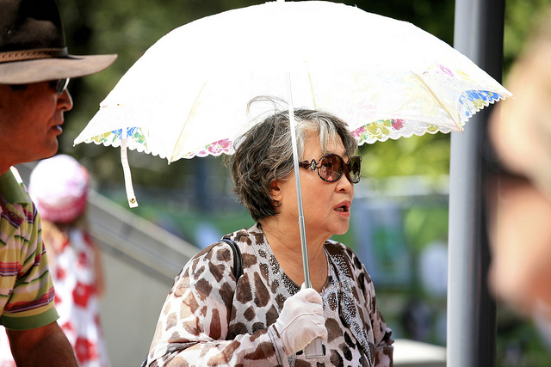
Increasingly Diverse Age Groups
Chinese outbound tourists:
Middle aged -> diverse demographic age mix
A growing number of older Chinese tourists is looking to invest their free time and money in travelling the world
Education strongly influences numbers of Chinese outbound travelers – many Chinese are studying overseas in the US, Australia and the UK, as well as in other countries and draw additional VFR (Visiting Friends and Relatives) visitors and also attract other related investment from China
More and more secondary school-aged students are also taking part in educational summer camps and exchange semesters
Notes:
While the first wave of Chinese outbound tourists were predominantly middle-aged, the demographic age mix is becoming increasingly diverse.
As things stand, as close to 60% of today’s travellers were born after 1980, with many of these even having being born since 1990.
As many of China’s first generation to become rich begin to reach their 60’s, they are finding themselves with more free time on their hands and are looking to invest their free time and money in travelling the world. Even those who were too old to benefit directly from China’s economic development are beginning to join their younger compatriots overseas, as their wealthier children pay for their international trips.
The growing numbers of younger Chinese people travelling abroad is being particularly driven by educational factors.
The most prominent example of this is the large number of Chinese tertiary students attending universities in countries such as the United States, Australia and the United Kingdom.
This has led to a growing industry of parents taking their children overseas to make campus visits before carefully choosing which university their child should go to.
While studying abroad, these Chinese students will also often attract their parents and friends as VFR (Visiting Friends and Relatives) travellers, drawing further Chinese arrivals to the destination.
Another lucrative by-product of this trend is the large sums of money Chinese parents invest in property and other study-related assets for their children when they are studying overseas.
The trend of young Chinese people studying overseas is now also beginning to spread beyond tertiary education to secondary-level students.
Teenaged school children of affluent parents are increasingly being sent abroad for overseas semesters and summer camps in order to increase their international experience, as well as gaining a more “elite” status within Chinese society.
Furthermore, younger children are being brought on overseas trips by their parents in increasing numbers as a means of “expanding their horizons”, and thereby tapping into the Chinese perception of travel as a form of education in itself.
Video:
Silver Travelers - China Outbound Travel Pulse - Episode 2
https://www.youtube.com/watch?v=ufPAeqIxCV0

Slide 10

Changing Patterns
As outbound travel experience grows in China, patterns in the travel preferences of outbound tourists from different parts of the country are becoming increasingly clear.
These can be influenced by factors ranging from geographical location, to the availability of flight connections. First and second tier city residents, who make up the majority of Chinese outbound travellers, are generally moving away from popular destinations in favour of more novel, less-visited locations.
At the same time, growing numbers of residents from third and fourth tier cities are starting to take their first trips abroad. This growth is being aided by the growing numbers of international flights and visa centres becoming available outside of first tier cities.
Notes:
Crucially, as an increasing number of China’s citizens gain more international experience, patterns in the travel preferences of outbound tourists from different parts of the country are becoming increasingly clear. These can be influenced by a number of factors, ranging from geographical location, to the availability of flight connections.
While less than 10% of Chinese citizens hold passports, the majority of these come from the country's first and second tier cities. Many of these more experienced and increasingly-independent travellers, especially those from first tier cities, are moving away from destinations popular with Chinese crowds in favour of more novel, less-visited locations.
While many of China’s travel pioneers are gaining more overseas experience, they are being joined by growing numbers of residents of third and even fourth tier cities taking their first trips abroad. Like 60% of all Chinese outbound tourists, these travellers tend to travel in groups. This growth is being aided by the growing numbers of international flights and visa centres becoming available outside of first tier cities.

Slide 11
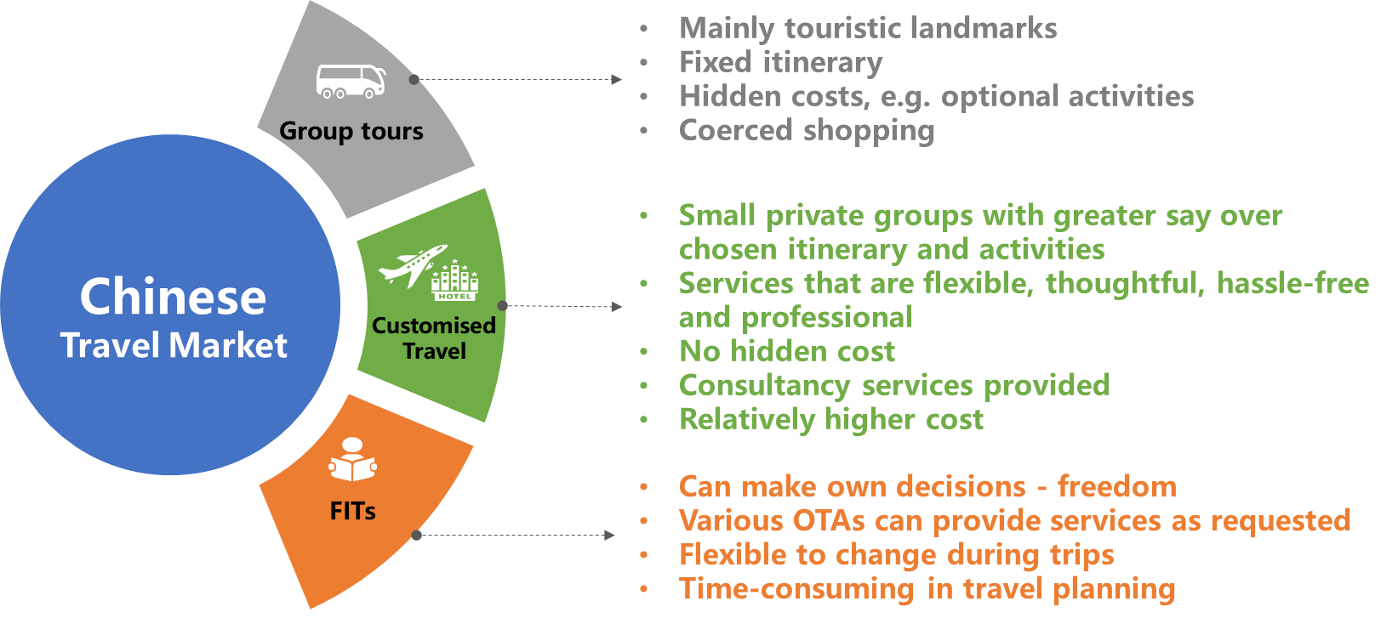
Segmentation Package Tour / Customised Travel / FIT
Compared to package group Chinese tourists, free individual travellers (FIT) and customised travel visitors are mostly wealthier upper-middle-class Chinese visitors who have already gained more experiences in outbound travel.
Many FITs and customised travel visitors thus have the potential to stay longer at each location, disperse wider, avoid peak seasons and crowded attractions, while in the same time still purchase tourism services and activities.
Travel form | 2017 | Forecast 2022
Package Tour | 44% | 30%
Customised Travel | 14% | 35%
FIT | 42% | 35%
www.china-outbound.com

Slide 12

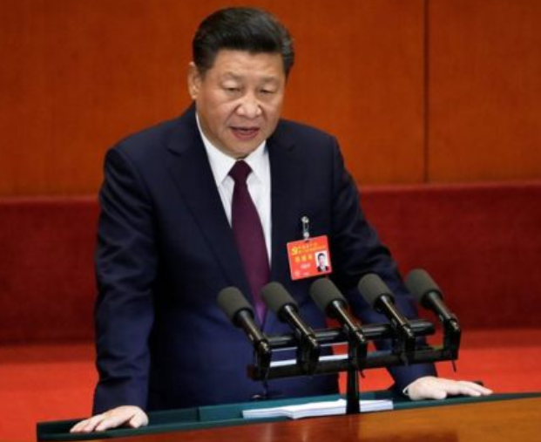
The Changing Role of China’s Outbound Tourism
TREND 2: Changing political role of Chinese outbound tourism in the “New Era”
Change of Chinese governments global policy – Soft Power through tourism and new international organisations – BRICS, Belt and Road Initiative, Shanghai Cooperation Organisation
韬光养晦
Taoguang Yanghui
“China has entered a New Era where it should take centre stage in the world.”
Xi Jinping , 19th CCP Congress October 2017

Slide 13
2018: The End of CNTA
– New Ministry of Culture and Tourism
New institutions
In March 2018 the National People‘s Congress (NPC) decided that the Ministry of Culture and CNTA China National Tourism Administration will be merged into a new Ministry of Culture and Tourism.
NPC official announcement: “The move is aimed at coordinating the development of cultural and tourism industries, enhancing the country's soft power and cultural influence, and promoting cultural exchanges internationally.”
The World Tourism Cities Federation (started 2012, Beijing) is becoming more important.
The new World Tourism Alliance (started 2017, Hangzhou) is building a big new headquarter in Hangzhou.

Slide 14
TREND 3: From Quantity to Quality
“Be careful what you wish for”: Many destination find themselves in a situation of being visited by large numbers of Chinese mass-market package tour groups, which boost the arrival numbers but stay only for a short period of time at a destination (concentrating on the most famous destinations and sights during high season) and create very limited yields.
With the growing importance of Chinese independent travellers (FITs) and Chinese Modular Outbound Travellers (MOTs), quality and value for money take the place of quantity and cheap price.
Chinese FITs and MOTs are tiring of travelling overseas and meeting mostly fellow countrymen in a destination, of engaging just in shopping and sightseeing. They become more and more interested in new, authentic offers based on local culture and nature if provided and communicated in the right way and through the right channels as Customized Travel.
In a survey of several hundred tour operators in China in Spring 2019, “Customised” was named as the main Trend Term for outbound tourism development.

Slide 15
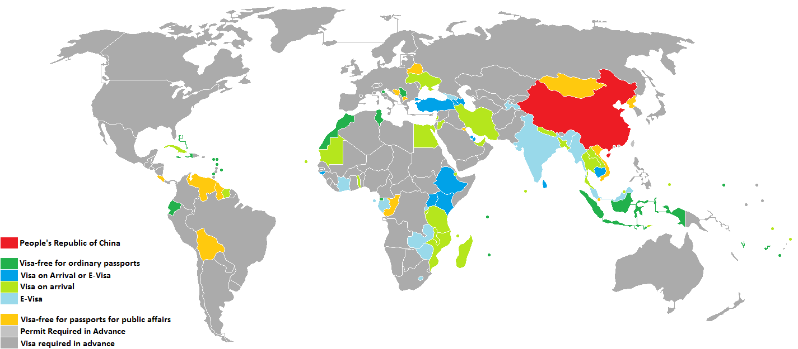
TREND 4: Rapid easing of visa requirements for Chinese outbound tourists
Visa free entry:
Simplified visa procedures
27 destinations offer visa-free entry for
Chinese citizens
39 destinations offer visa on arrival or E-Visa
for Chinese citizens
Asia | UAE
 | Jeju Province, South Korea
 | Indonesia
 | Quang Ninh Province, Vietnam
North America | Barbados
 | Bahamas
 | Grenada
 | Antigua and Barbuda
 | Dominica
 | Haiti
 | Saint Kitts and Nevis
 | Turks and Caicos Islands
 | Jamaica
South America | Ecuador
Europe | Serbia
 | San Marino, Albania, Bosnia & Hercegovina
Oceania | Fiji
 | Tonga
 | French Polynesia
 | Northern Mariana Islands
 | Samoa
Africa | Mauritius
 | Seychelles
 | Réunion
 | Morocco
 | Tunisia
Antarctic | South Georgia and the South Sandwich Islands

Slide 16
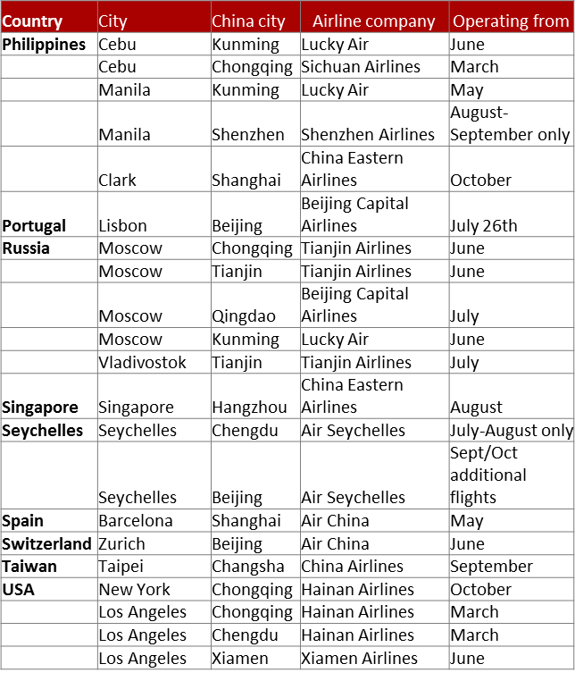
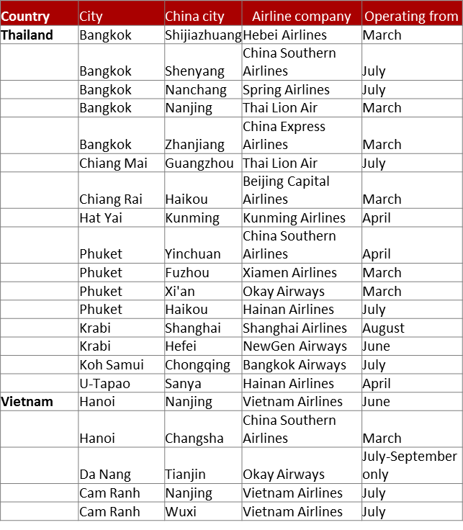
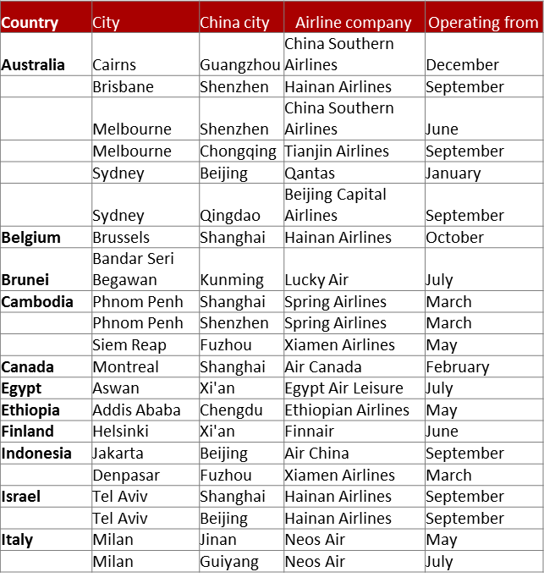
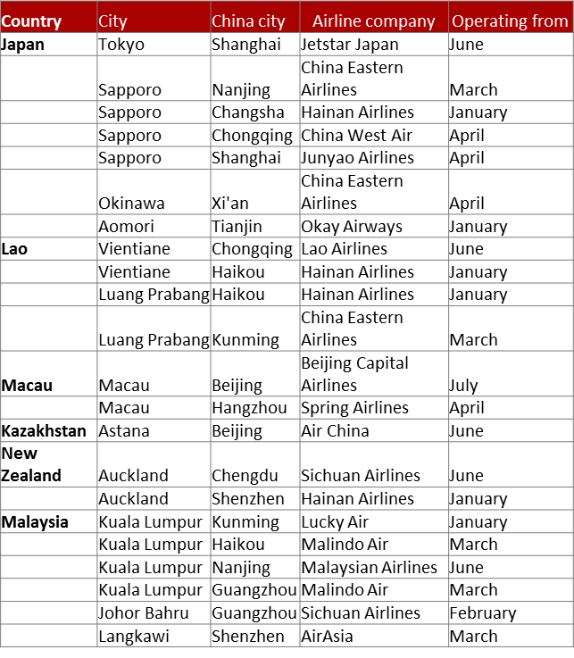

TREND 5: Improved connectivity for second tier airports in China and in host destinations
More direct flight connections
Every year in the last few years more than 100 new air connections were started, mostly connecting second tier airports in China and abroad

Slide 17
TREND 6: Better information
More information available
Most global destinations have intensified their provision of information to both Chinese outbound tour operators and to potential FIT visitors, using fairs like the new ITB China or Social Media in the form of WeChat channels entries, online trainings, and increasingly videos.
With each year of Chinese travellers visiting more diverse destinations the chance is getting bigger for potential travellers to know somebody (in real life or online) who already visited a specific destination and can give advise, making it easier to organize a trip without the help of a tour operator.
IT and AI provide increasingly sophisticated tools to receive customized information before and during the trip.

Slide 18
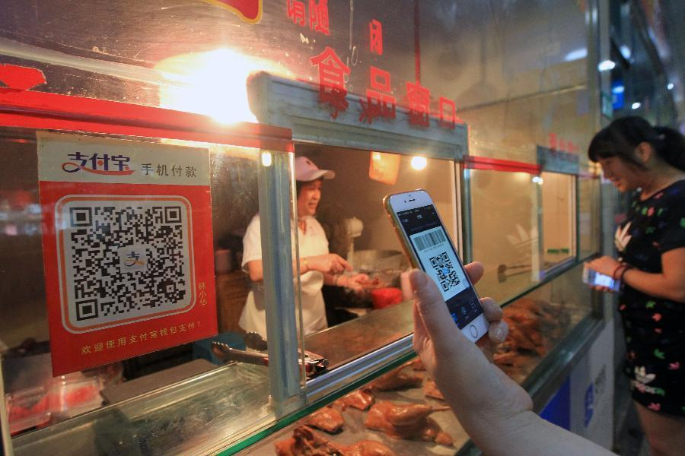



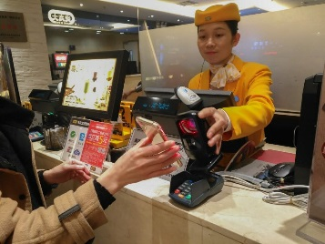
TREND 7: Mobile Payment
Prior to the emergence of mobile payment apps in China, the country was primarily a cash-based society.
However today, apps like Alipay and WeChat are transforming China into a cashless society where transactions are commonly carried out via the phone in your pocket.

Slide 19
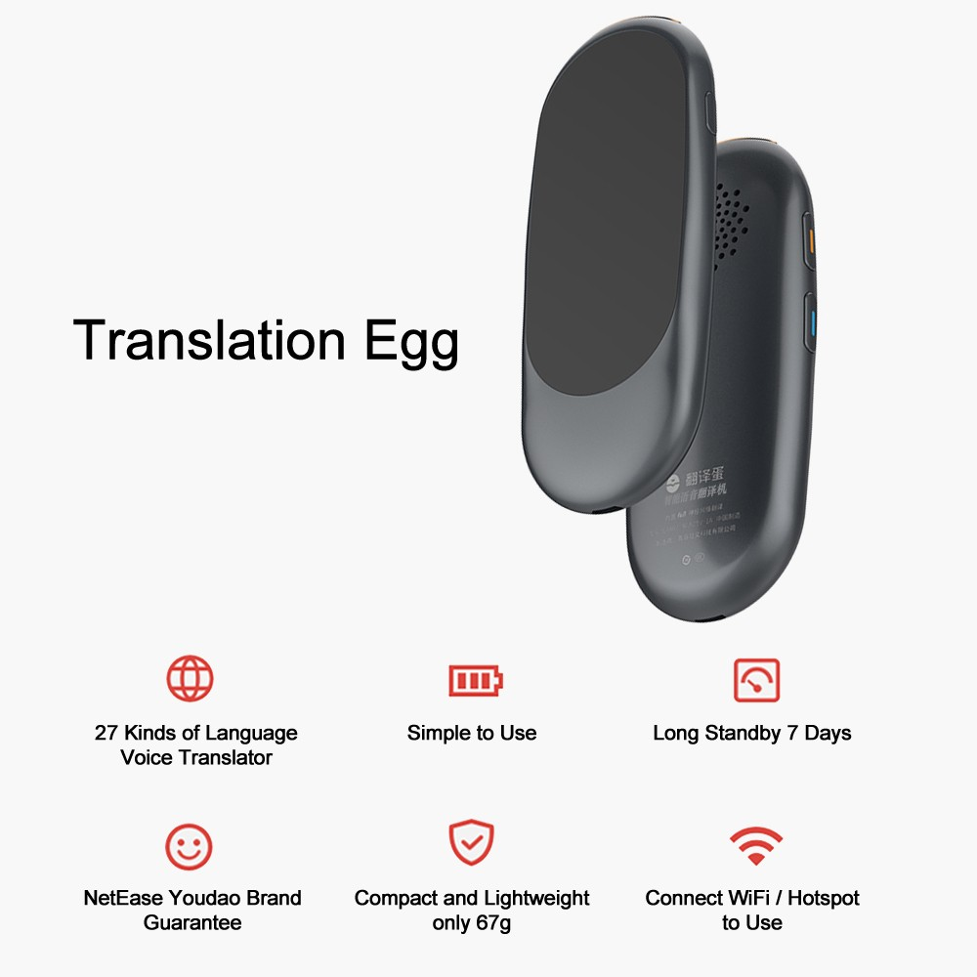
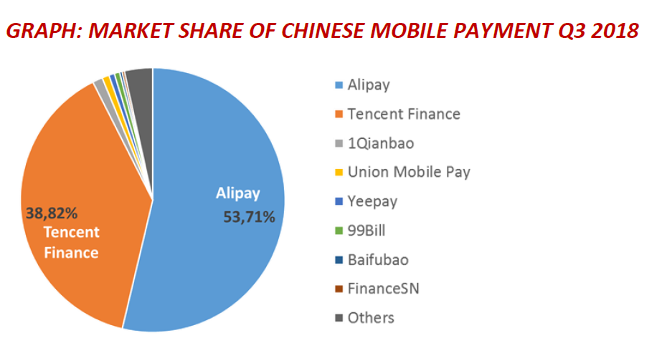
TREND 8: Technology helps

Slide 20
Chinese Outbound Tourism Example Cambodia
Source: COTRI ANALYTICS

Slide 21
Chinese Outbound Tourism Example Cambodia
Source: COTRI ANALYTICS

Slide 22
Market Development of Chinese tourism to Cambodia
2011 First time close to a quarter of a million arrivals
2014 First time more than half a million arrivals - Leisure visitors concentrated in Siem Reap (Angkor Wat) and Phnom Penh
2016 Thailand Tourism Authorities clamp down on Zero-Dollar-Tours,
Chinese Zero-Dollar tour operators move to other destinations including
Cambodia
Start of major investments of Chinese in tourism infrastructure in
Sihanoukville
2018 1.1 billion USD Chinese investment in Sihanoukville
2019 Market Share of Angkor Wat decreasing, boom in Sihanoukville
        90% of all businesses in Sihanoukville, including 48 casinos, 150 restaurants and 87 karaoke clubs and massage parlours, owned by Chinese nationals according to a report by the provincial authorities
www.china-outbound.com
2019

Slide 23

Comparison with Competitors of Cambodia
The Cambodian Tourism Minister Thong Khon predicted in June 2019 that Cambodia would get 2.6 million Chinese tourists in 2019, 3 million in 2020, 5 million in 2025 and up to 8 million in 2030.
He was speaking during the Joint cultural show held on June 5th, 2019 in Phnom Penh to celebrate the China-Cambodia Culture and Tourism Year.
Held at the Diamond Island's Grand Theater, the event was also to greet the visit of 2,000 Chinese tourism envoys to Cambodia.

Slide 24
Comparison with Competitors of Cambodia
 | Cambodia | Sri Lanka | Nepal | India | South Africa
Visa regulation | Visa-on-arrival | Visa exemption (from August 1st, 2019) | e-Visa | e-Visa | In-person interview for visa application
Price level in comparison to China | Equivalent to China's first and second tier cities | Equivalent to China's second/third tier cities | Equivalent to China's third/fourth tier cities | Equivalent to China's third tier cities | Equivalent to or even more than the first tier cities in China
Main market segments (target group) | Families, couples, friends | Families, couples | Friends, individuals | Families, friends, individuals | Families, friends
Main activities | Sightseeing, nature, beach, Buddhism, Gaming | Sightseeing, ocean, honeymoon | Sightseeing, culture learning, outdoor activities, Gaming | Sightseeing, culture learning, outdoor activities, religious activities | Sightseeing, wildlife, outdoor activities, Gaming
Main reasons to visit | Leisure, business | Leisure, business | Leisure, business | Leisure, business | Leisure, business
Main reasons not to visit | Language barrier, unstable material supply, pollution, inconvenient transportation | Terror attack, inconvenient transportation, low efficiency | Unstable / inadequate material supply, bad sanitation / medical service, language barrier | Poor public security, bad sanitation, disordered tourism services, inconvenient transportation | Poor public security, violent attacks, difficult visa application

Slide 25

Successful Development of Chinese Outbound Tourism
COTRI China Outbound Tourism Research Institute | china-outbound.com | +49 40 558 99 576
COTRI China Outbound Tourism Research Institute | china-outbound.com | +49 40 558 99 576

Slide 26
End of bi-polar market split
The Chinese outbound tourism market is splitting into three main ways of travelling modi which will soon reach about equal importance:
- Package tour groups (low price, low interest, concentrating on main sights)
- Customised group tours (high price, special interest, flexible in time&area)
- FITs (middle to high price, younger, searching for themselves)

Slide 27
Asia still number one – China still number one
Asia will remain the first choice for new international travellers from lower tier cities, but Asian destinations will lose market share for HNWI and affluent travellers for main leisure trip.
Asia will remain the first choice for shorter recreation-orientated trips.
China will continue to change international tourism, shaping services and destinations according to their specific needs and expectations.

Slide 28
Common features still important for product adaptation
Common features of almost all Chinese travellers will make adaptations still necessary:
Money Rich, Time Poor – Make products shorter
Documentation – Nobody believes anything in China: Videos, Certificates, Proof on Website or in Social Media
Prestige – Give face, provide photo opportunity with (if needed self-made) celebrity, stress superlatives
Engagement for China – Proof of company/destination going the extra mile for Chinese visitors by trainings, special services
Connecting with China – Storytelling which connect local history, sights, and traditions with China

Slide 29
New trends
Niche topics, themed tours and bespoke arrangements are becoming more important
“Second Wave” travellers from China moving from “money rich and time poor” to “money and experience rich and time poor”
95% of affluent and travel-savvy “Second Wave” travellers have already been to most important Asian destinations (Thailand, Japan, South Korea)
Visa difficulties are becoming ever less of an issue, helping the development of special interest tours

Slide 30


Four traps to avoid for destinations working with the Chinese outbound tourism market

Slide 31
Trap No. 1
The Florida* trap
Telling the same story to all markets – what works for customers on the other side of the Atlantic, does not work for those coming from the other side of the Pacific.
* Florida only gets 3% of all Chinese arrivals to USA

Slide 32
Trap No. 2
The Maldives*, Mauritius**, Fiji & Louis Vuitton trap
Starting as a luxury destination, but lowering the prices under pressure from Chinese tour operators, losing bragging rights and accordingly visitors as the destinations appears to become common.
* Maldives 2015: 365,000 Chinese arrivals, 2017: 305,000 arrivals
** Mauritius 2015: 90,000 Chinese arrivals, 2017: 60,000 arrivals

Slide 33
Trap No. 3
The Sri Lanka, Nepal, Spain, Norway, Palau and many others trap
Being successful in increasing arrival numbers by offering low prices for package tours, resulting in pushing out traditional markets and environmental destruction without earning much money or gaining satisfied Chinese customers in the process – a dangerous process also for CAMBODIA.

Slide 34
Trap No. 4
The many places trap – alienating locals
Many destinations are suffering from overtourism, an overflow of visitors or the pushing aside of the local tourism service providers by investors.
Often Chinese are singled out as the main “problem”.
“The image of China in Cambodia has been affected by what’s happened in Sihanoukville,” says Vannarith Chheang, co-founder of the Cambodian Institute for Strategic Studies. “There is rising anti-China rhetoric in Cambodia. .. It is important for China to win the hearts of the Cambodian people.
If China fails in Cambodia, it will fail in the region.”
(South China Morning Post, August 7th, 2018)

Slide 35

The Chinese Market Success Ladder
Six steps up the ladder to success in the Chinese market:
Higher arrival numbers →
Higher number of overnights →
Higher level of spending per visitor per trip→
Higher margin →
higher level of satisfied Chinese visitors,
recommending the destination to their peers→
Non-alienated locals.

