Slide 1
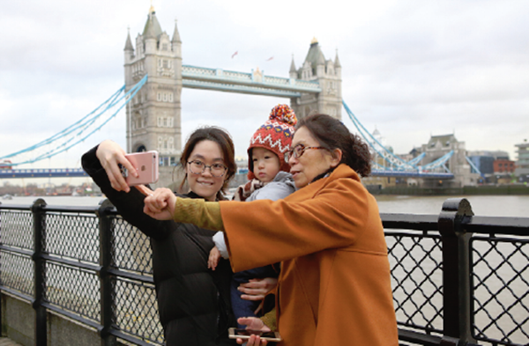

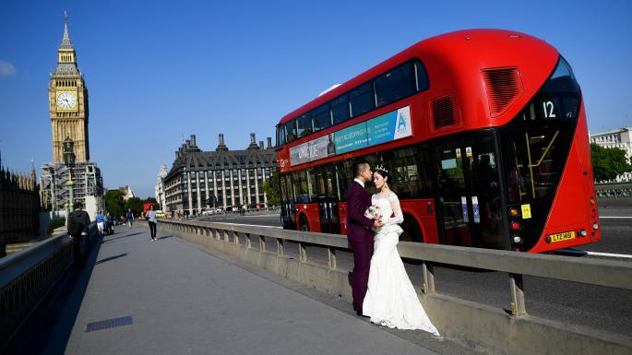


Emerging Market No. 1: Chinese outbound tourism

Slide 2
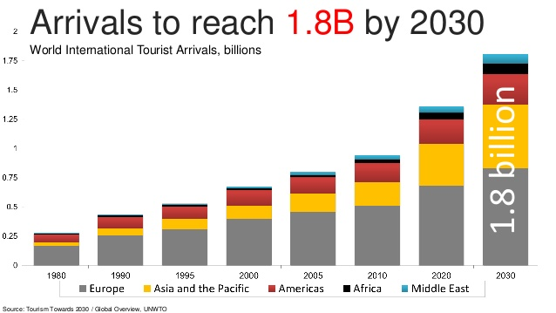
Global international tourism growth up to 2030
The UNWTO graph illustrates the strong growth of international tourism, with a forecast of reaching 1.8 billion border-crossing trips by 2030, adding 500 million to the 1.32 billion of 2017.
Already today about 11% of all arrivals are generated by Mainland Chinese.

Slide 3
Chinese outbound tourism up to 2018

Slide 4

The Attitude of Chinese Travellers Towards Outbound Tourism –
Gaining Knowledge
“One trip equals reading 10,000 books”
In Chinese culture, travelling has a long and positive tradition.
Since ancient times, mobility has been important for scholars,
administrators, monks and pilgrims.
Travelling is seen as a way of understanding the nature
of the world and of oneself.
Travelling in most cases however happened within
China, Xu Xiake, depicted on the stamp, was no
Marco Polo or Ibn Battuta. Exceptions: Buddhist monks
and Zheng He (1371-1433), the “Chinese Columbus”.
Xu Xiake 1587-1641

Slide 5
Political Background of Chinese Outbound Tourism
1983
  The government permitted citizens to travel abroad for private reasons, but only for those who had relatives abroad. This type of travel first took place between Mainland China and Hong Kong or Macau.
1987
  First cross-border travel to North Korea. Starting from this year, the Chinese government gradually approved of travelling to neighbouring countries to visit relatives and family members.
1997
  Official start of outbound travel from China. The “Provisional Regulation on the Management of Outbound Travel by Chinese Citizens at their own Expense” for the first time acknowledges Chinese citizens’ demand for leisure travel.
2012
  China becomes the biggest source market of international tourists worldwide.
2015
  Following in the footsteps of the United States, numerous destinations begin to introduce multiple-entry tourist visas for Chinese passport holders.
2018
  Ministry of Culture and Tourism started.

Slide 6
Chinese outbound tourism First half 2018
COTRI reports for the first half of 2018 a total of 80 million border crossings, with more than half going beyond Greater China, an increase of 16% YoY.
The Chinese Ministry of Culture and Tourism published a total of 71.3 million Chinese border crossings for the first half of 2018, an increase of 15% YoY.

Slide 7
Chinese outbound tourism 2018-2030
COTRI forecasts that 2018 will see a total of 160 million Chinese arrivals worldwide, which would consist of 75 million trips made to Greater China destinations and 85 million to the rest of the world.
By 2030, 390 million outbound trips will originate in Mainland China, most of them going beyond Greater China, 250 million more than 2017 - meaning
HALF of the additional outbound travellers in next decade will be CHINESE.

Slide 8

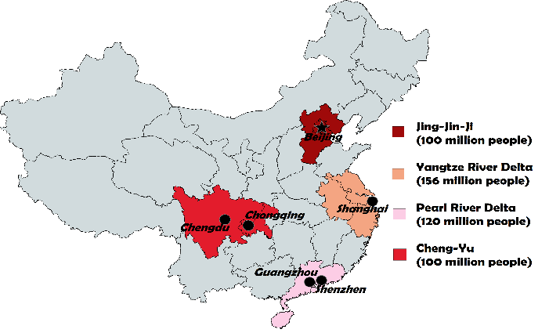
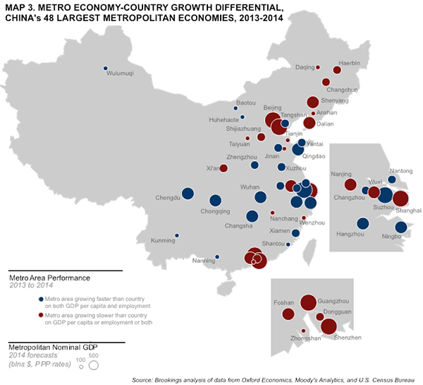
Chinese outbound tourism growth potential
Today no more than 10% of Chinese citizens possess passports
Almost all live in 1st and 2nd tier cities
Until Now Only Four Economic Regions As
Main Tourist Source Regions
The vast majority of Chinese have yet to experience their first-ever long-distance leisure trip (inside or outside China)

Slide 9


The Changing Role of China’s Outbound Tourism
Changing role of outbound tourism
Change of Chinese governments global policy – Soft Power through tourism and new international organisations – BRICS, Belt and Road Initiative, Shanghai Cooperation Organisation
韬光养晦
Taoguang Yanghui
“China has entered a New Era where it should take centre stage in the world.”
Xi Jinping , 19th CCP Congress October 2017

Slide 10
2018: The End of CNTA
– New Ministry of Culture and Tourism
New institutions
In March 2018 the National People‘s Congress (NPC) decided that the Ministry of Culture and CNTA China National Tourism Administration will be merged into a new Ministry of Culture and Tourism.
NPC official announcement: “The move is aimed at coordinating the development of cultural and tourism industries, enhancing the country's soft power and cultural influence, and promoting cultural exchanges internationally.”
The World Tourism Cities Federation (started 2012, Beijing) becoming more important.
The new World Tourism Alliance (started 2017, Hangzhou) building big new headquarter in Hangzhou.

Slide 11

Rich and Poor in China
Since the start of the reform and opening process in 1978 in China:
Living standards have risen throughout the country
The income gap between the more developed coastal regions and the less developed inland regions increased
By 2015, the wealthiest 10% of Chinese society owned 70% of the country’s private wealth.
Notes:
Since the start of the reform and opening process in China, living standards have risen throughout the country, but it has also caused the income gap between the more developed coastal regions and the less developed inland regions to increase.
By 2015, the wealthiest 10% of Chinese society owned 70% of the country’s private wealth, up from a 40% share in 1995.
http://www.economist.com/news/finance-and-economics/21717102-why-chinese-citizens-seem-more-tolerant-rising-inequality-westerners-new

Slide 12
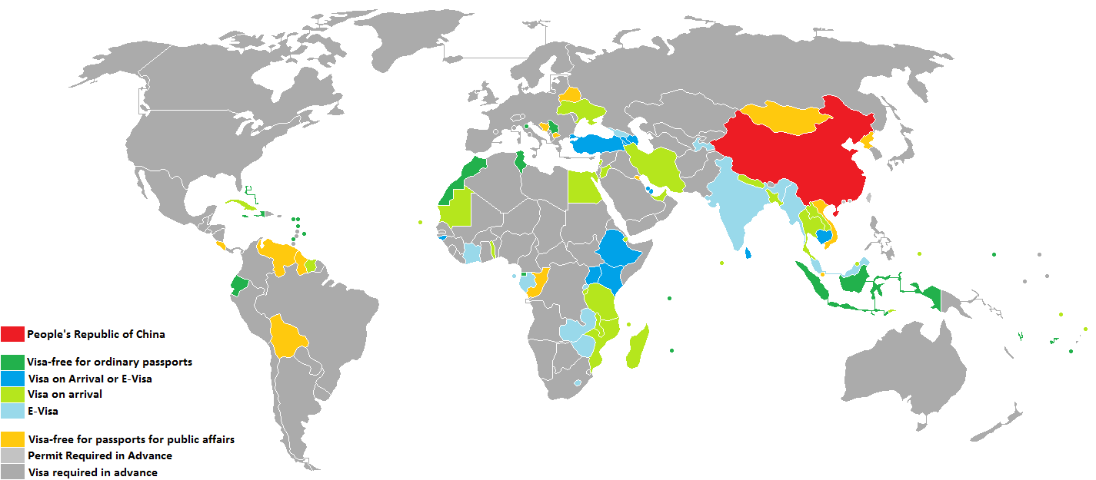
Three main drivers for China’s outbound tourism in 2018: 1. Visa
Visa free entry:
Simplified visa procedures
27 destinations offer visa-free entry for
Chinese citizens
39 destinations offer visa on arrival or E-Visa
for Chinese citizens
Asia | UAE
 | Jeju Province, South Korea
 | Indonesia
 | Quang Ninh Province, Vietnam
North America | Barbados
 | Bahamas
 | Grenada
 | Antigua and Barbuda
 | Dominica
 | Haiti
 | Saint Kitts and Nevis
 | Turks and Caicos Islands
 | Jamaica
South America | Ecuador
Europe | Serbia
 | San Marino, Albania, Bosnia & Hercegovina
Oceania | Fiji
 | Tonga
 | French Polynesia
 | Northern Mariana Islands
 | Samoa
Africa | Mauritius
 | Seychelles
 | Réunion
 | Morocco
 | Tunisia
Antarctic | South Georgia and the South Sandwich Islands

Slide 13
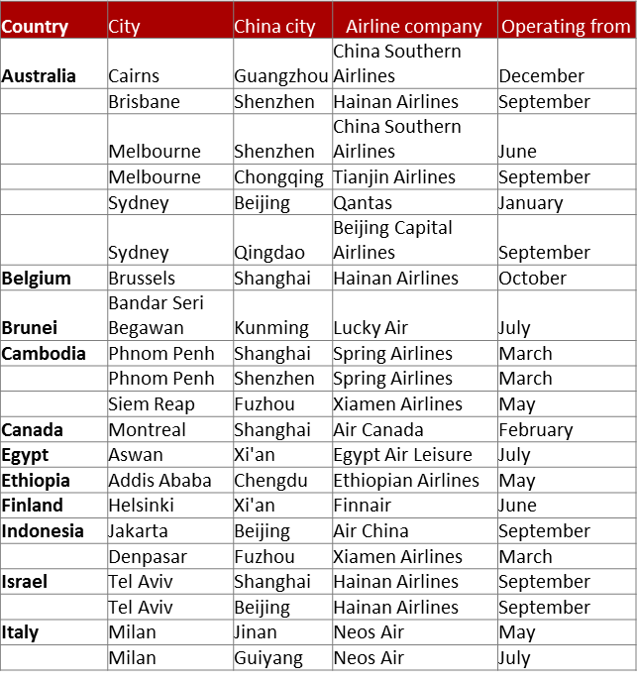
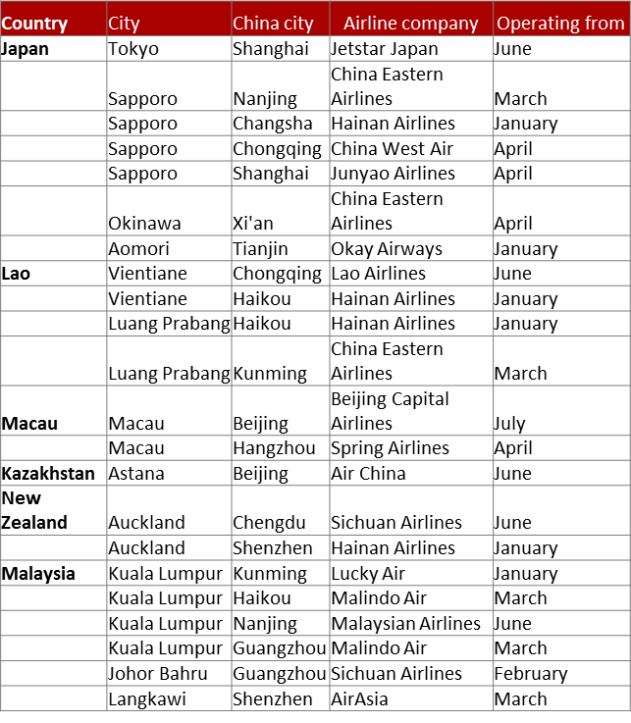

Three main drivers for China’s outbound tourism in 2018: 2. Connectivity
More direct flight connections
In 2017 more than 100 new air connections were started, with more in the pipeline for 2018, mostly connecting second tier airports in China and abroad.

Slide 14
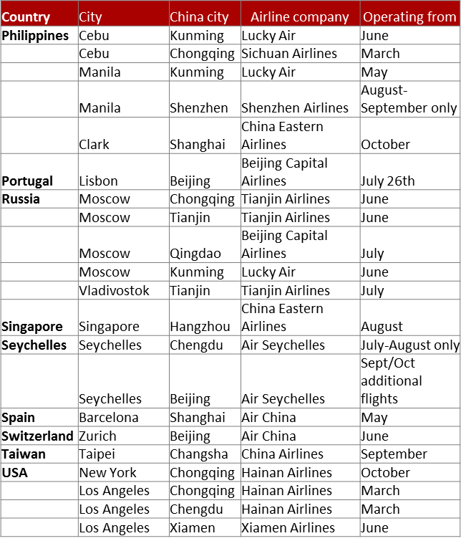
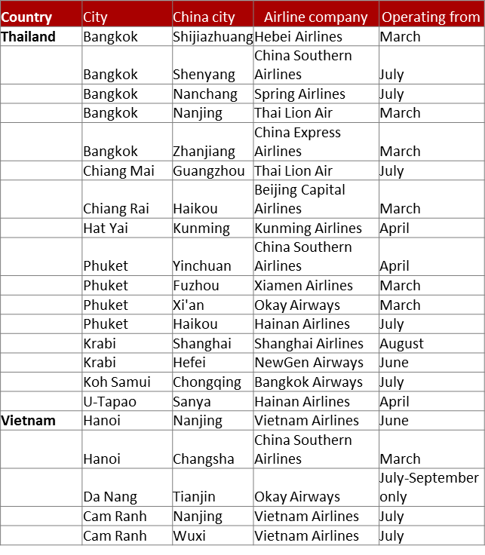
Three main drivers for China’s outbound tourism in 2018: 2. Connectivity

Slide 15
Three main drivers for China’s outbound tourism in 2018:
3. Information and Mobile Payment
More information available
Most global destinations have intensified their provision of information to both Chinese outbound tour operators and to potential FIT visitors, using fairs like the new ITB China or Social Media in the form of WeChat channels entries, online trainings, and increasingly videos.
With each year of Chinese travellers visiting more diverse destinations the chance is getting bigger for potential travellers to know somebody (in real life or online) who already visited a specific destination and can give advise, making it easier to organize a trip without the help of a tour operator.
IT and AI provide increasingly sophisticated tools to receive customized information before and during the trip.

Slide 16
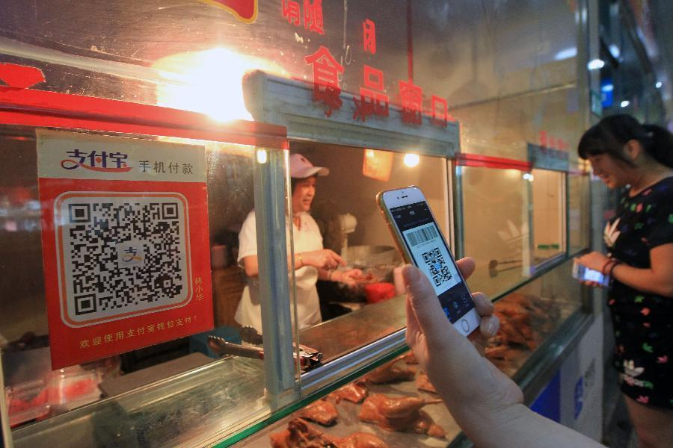



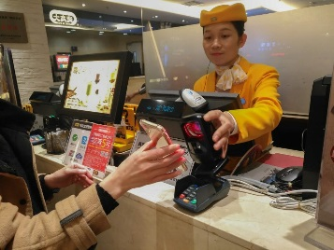
Three main drivers for China’s outbound tourism in 2018:
3. Information and Mobile Payment
Prior to the emergence of mobile payment apps in China, the country was primarily a cash-based society.
However today, apps like Alipay and WeChat are transforming China into a cashless society where transactions are commonly carried out via the phone in your pocket.

Slide 17

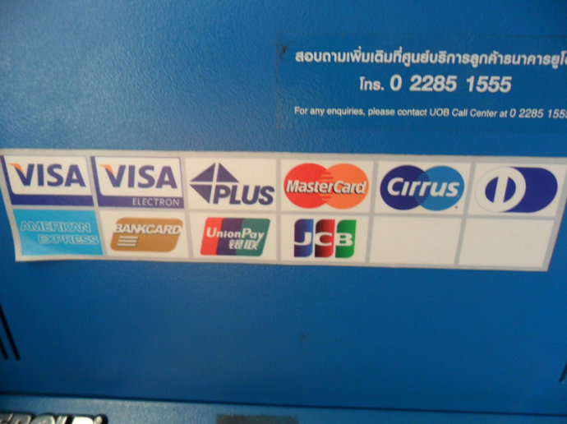

Three main drivers for China’s outbound tourism in 2018:
3. Information and Mobile Payment
Chinese outbound travellers used to be happy if tourism service providers, retailers and ATMs accepted UnionPay credit cards.
Chinese travellers now are demanding strongly the acceptance of mobile payment
freeing them from money exchange and danger of pickpocket thefts.
If shops and service providers do not accept AliPay or WeChat Pay, a growing number of them will try to find another business offering this service.
Accepting mobile payment has developed from an extra service to a necessity.

Slide 18

Shifting Patterns
As outbound travel experience grows in China, patterns in the travel preferences of outbound tourists from different parts of the country are becoming increasingly clear.
These can be influenced by factors ranging from geographical location, to the availability of flight connections. First and second tier city residents, who make up the majority of Chinese outbound travellers, are generally moving away from popular destinations in favour of more novel, less-visited locations.
At the same time, growing numbers of residents from third and fourth tier cities are starting to take their first trips abroad. This growth is being aided by the growing numbers of international flights and visa centres becoming available outside of first tier cities.
Like 60% of Chinese outbound tourists, they typically travel in groups.
Notes:
Crucially, as an increasing number of China’s citizens gain more international experience, patterns in the travel preferences of outbound tourists from different parts of the country are becoming increasingly clear. These can be influenced by a number of factors, ranging from geographical location, to the availability of flight connections.
While less than 10% of Chinese citizens hold passports, the majority of these come from the country's first and second tier cities. Many of these more experienced and increasingly-independent travellers, especially those from first tier cities, are moving away from destinations popular with Chinese crowds in favour of more novel, less-visited locations.
While many of China’s travel pioneers are gaining more overseas experience, they are being joined by growing numbers of residents of third and even fourth tier cities taking their first trips abroad. Like 60% of all Chinese outbound tourists, these travellers tend to travel in groups. This growth is being aided by the growing numbers of international flights and visa centres becoming available outside of first tier cities.

Slide 19
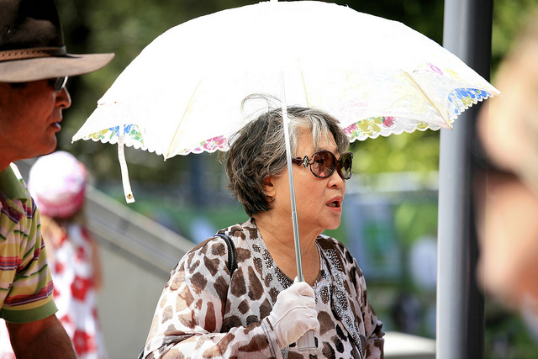
Increasingly Diverse Age Groups
Chinese outbound tourists:
Middle aged -> diverse demographic age mix
A growing number of older Chinese tourists is looking to invest their free time and money in travelling the world
Education strongly influences numbers of Chinese outbound travelers – many Chinese are studying overseas in the US, Australia and the UK, as well as in other countries and draw additional VFR (Visiting Friends and Relatives) visitors and also attract other related investment from China
More and more secondary school-aged students are also taking part in educational summer camps and exchange semesters
Notes:
While the first wave of Chinese outbound tourists were predominantly middle-aged, the demographic age mix is becoming increasingly diverse.
As things stand, as close to 60% of today’s travellers were born after 1980, with many of these even having being born since 1990.
As many of China’s first generation to become rich begin to reach their 60’s, they are finding themselves with more free time on their hands and are looking to invest their free time and money in travelling the world. Even those who were too old to benefit directly from China’s economic development are beginning to join their younger compatriots overseas, as their wealthier children pay for their international trips.
The growing numbers of younger Chinese people travelling abroad is being particularly driven by educational factors.
The most prominent example of this is the large number of Chinese tertiary students attending universities in countries such as the United States, Australia and the United Kingdom.
This has led to a growing industry of parents taking their children overseas to make campus visits before carefully choosing which university their child should go to.
While studying abroad, these Chinese students will also often attract their parents and friends as VFR (Visiting Friends and Relatives) travellers, drawing further Chinese arrivals to the destination.
Another lucrative by-product of this trend is the large sums of money Chinese parents invest in property and other study-related assets for their children when they are studying overseas.
The trend of young Chinese people studying overseas is now also beginning to spread beyond tertiary education to secondary-level students.
Teenaged school children of affluent parents are increasingly being sent abroad for overseas semesters and summer camps in order to increase their international experience, as well as gaining a more “elite” status within Chinese society.
Furthermore, younger children are being brought on overseas trips by their parents in increasing numbers as a means of “expanding their horizons”, and thereby tapping into the Chinese perception of travel as a form of education in itself.
Video:
Silver Travelers - China Outbound Travel Pulse - Episode 2
https://www.youtube.com/watch?v=ufPAeqIxCV0

Slide 20
Who Is Travelling?
So who are the Chinese outbound travellers?
Outbound tourism is an upper class phenomenon in China - less than 10% of Mainland Chinese people have ever crossed a border and only about 5% of Chinese tourists are affluent enough to travel intercontinentally
Remember: The 145 million border crossings in 2017 were not made by 145 million different people
Notes:
Outbound tourism is an upper class phenomenon in China; less than 10% of Mainland Chinese people have ever crossed a border and only about 5% of Chinese tourists are affluent enough to travel intercontinentally.
Remember: The 145 million border crossings in 2017 were not made by 145 million different people
While around 70% of Chinese outbound travellers were born in the 1970’s or 1980’s, the age structure is spreading. In fact, as many as 12% were born in the 1990’s and 5% in the 1950’s.

Slide 21
“The” Chinese Outbound Traveller does not exist
Chinese FIT are more affluent than Western FIT, most of them spend also more than group travellers. They are price sensitive in both directions, looking out for bargains but also willing to pay premium prices for value for money offers with high bragging power.
Most of them are seekers of prestige and self-affirmation, trying to find themselves abroad. They often pursue “serious leisure” activities, often choosing the activity, not the destination, first.
FIT Second Wave travellers more open to suggestions, but also more confident and demanding than ever. They can be attracted to new places, new activities, new times of the year, bringing not only more, but a different kind of business.
Almost all Chinese travellers are „Money rich, but time Poor“. For them there can be no “cheap” far-away destination, as they have to pay with their travel time.
.

Slide 22
First tier inhabitants: Living like a local (for a short time)
For affluent 1st tier city inhabitants international travel is already fixed part of consumption pattern, mostly travel self-organised or customised tour for fixed group
More and more segmentations into niches including big niches like health tourism, cruises, food and wine, adventure, educational etc.
Second Wave experienced Chinese travellers: Niche topics, themed tours, bespoke arrangements, activity based trips, moving from “money rich but time poor” to “money and experience rich but time poor”
Key motivation to choose destination: Not too many (but not none) Chinese have travelled yet to this place

Slide 23
Second tier citizens: Following KOLs to “must-sees”
Aspiring 2nd and 3rd tier city inhabitants catching up fast, most growth comes from lower tier cities
Older customers starting with package tour, younger travellers move directly to half-/ or self-organised tour
For young families or 6+1 multigenerational groups self-drive / LV gaining importance
More likely to still ticking off the „must-see“ list of destinations and sights
Key motivation to choose destinations: All KOLs and some of my friends have already been there

Slide 24
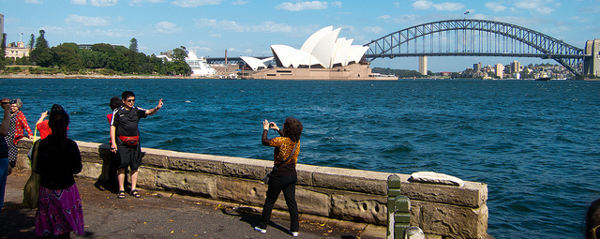
The Attitude of Chinese Travellers Towards Long-distance Outbound Tourism – No Holidays!
Chinese people do not travel to distant locations simply for a holiday and/or for relaxation.
Long-haul leisure trips are undertaken mainly to acquire personal status and useful knowledge about the local culture, economy and the technology of other countries or even to gather information for investments abroad in real estate and companies.

Slide 25

Starting Chinese Quality Tourism
Five steps up the ladder to success in the Chinese market:
Higher arrival numbers →
Higher number of overnights →
Higher level of spending per visitor per trip→
Higher margin →
higher level of satisfied Chinese visitors,
recommending the destination to their peers.
There is no point in just aiming at “more” Chinese arrivals.

Slide 26
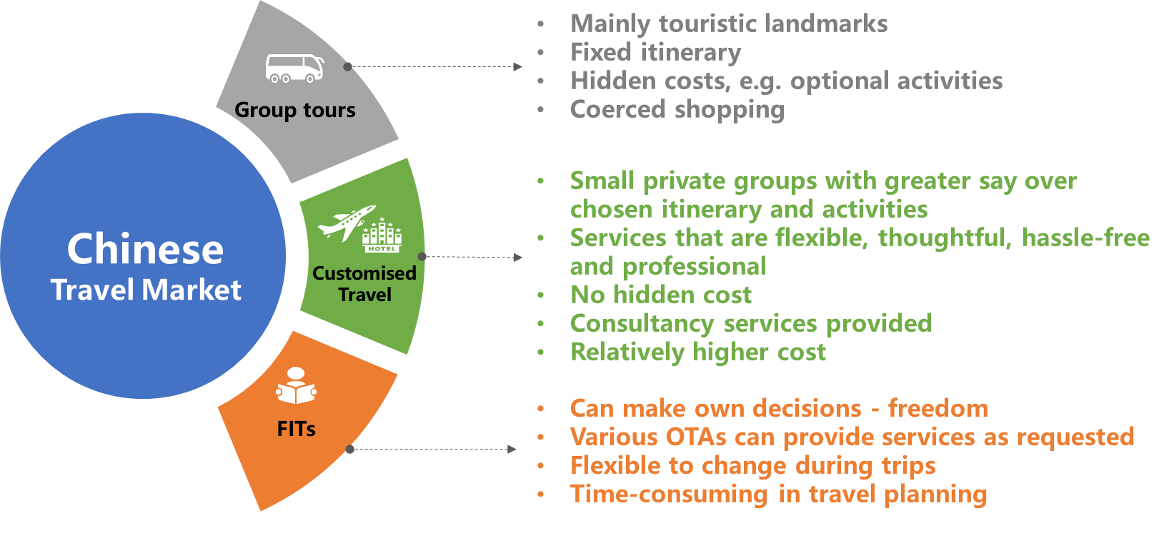
Customised Travel: The fastest growing sector
Ctrip approach: Customised Travel
Customised travel advantages
Growing number of Chinese travelling as FITs.
But FITs’ experience is not suitable for everyone.
Customised tours start to take significant shares.
Ctrip 2017:
package group tours 44%
FIT related products 42%
Private groups and customised tours 14%

Slide 27


Six Traps to avoid in Chinese outbound tourism

Slide 28
Trap No. 1
The Florida* trap
Telling the same story to all markets – what works for customers on the other side of the Atlantic, does not work for those coming from the other side of the Pacific.
* Florida only gets 3% of all Chinese arrivals to USA

Slide 29
Trap No. 2
The Maldives*, Mauritius**, Fiji & Louis Vutton trap
Starting as a luxury destination, but lowering the prices under pressure from Chinese tour operators, losing bragging rights and accordingly visitors as the destinations appears to become common.
* Maldives 2015: 365,000 Chinese arrivals, 2017: 305,000 arrivals
** Mauritius 2015: 90,000 Chinese arrivals, 2017: 60,000 arrivals

Slide 30
Trap No. 3
The Sri Lanka, Nepal, Spain, Norway, Palau and many others trap
Being successful in increasing arrival numbers by offering low prices for package tours, resulting in pushing out traditional markets and environmental destruction without earning much money or gaining satisfied Chinese customers in the process – ultimately killing the brand.

Slide 31
Trap No. 4
The Tunisia trap
Being used to international visitors coming for a longer period of time for adventure and relaxation, enjoying the laid-back lifestyle, having difficulties in understanding the needs of a need customer group of visitors who come to WA to work on their bragging rights, status, social capital and self-esteem, who are leisure tourists, but not holiday makers.

Slide 32
Trap No. 5
The Füssen etc. trap – locals blaming Chinese travellers for overtourism
Six steps up the ladder to success in the Chinese market:
Higher arrival numbers →
Higher number of overnights →
Higher level of spending per visitor per trip→
Higher margin →
higher level of satisfied Chinese visitors,
recommending the destination to their peers→
Non-alienated locals.

Slide 33



Trap No. 6
The USA, UK & Brazil trap – putting welcome into question
Pushing through government policies which create uncertainty about the level of welcome for foreigners and about the possibility to visit the destination short term or long term, including studies and investment.

