Slide 1
International Management I
Globalisation Strategies

Slide 2
Globalisation of companies
Globalisation
General conditions
- Liberalised markets for goods and finances
- Growing importance of supranational organisations (WTO, EU, ASEAN)
- Development of IT
- Faster, more reliable and cheaper transport and logistics
Demand
- Homogenisation of Demand
- Global customers
Need to globalise
- Global competition with other companies
- Global competition inside global company
Supply
- Economy of scale in sourcing and production
- High R&D costs
- Shortening product life cycles

Slide 3
Going-International Strategies
Major strategic decisions:
Selection of countries and market segments
Market entry and Market development strategies
Timing Strategies
Overall analysis (ongoing)
Global or Niche market strategy
SWOT analysis for specific project
Information

Slide 4
SWOT-Analysis
Internal analysis
Strengths
External analysis
Opportunities
Weaknesses
Threats
Information

Slide 5
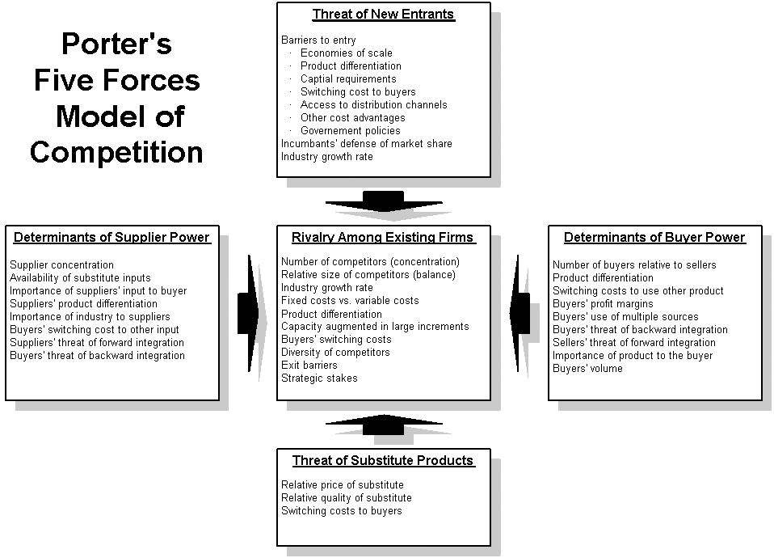

Slide 6
Market entry and Market development strategies
Direct Export
Direct Export to international customers
Use of local representative or own representative in foreign country
Electronic Commerce
Often first step of Internationalisation of a company
Information

Slide 7
Market entry and Market development strategies
Indirect Export
Use of export companies specialized for special target markets
Use of import companies in target market
Export company works for their own account and handle red tape
Use of sales representatives
Information

Slide 8
Market entry and Market development strategies
Licencing
Opening up market, which are difficult to serve with exports because of trade barriers, prohibitive transport costs, etc.
Licences giving company needs Know-how:
Patents, Copyrights
Technical Know-how or
Marketing and Management Know-how
Production and distribution done by licencees
Licence giving company is paid a lump-sum fee and/or monthly/annual fee
Example: Coca-Cola
Information

Slide 9
Market entry and Market development strategies
Franchising
Complete business concept is given to franchisee
Difference between Licence and Franchise:
Brand, CI, Marketing- und Management-Know-how is franchised
Stronger influence by licence giving company
Used especially for easy-to-understand products and services
Example: Benetton
Information

Slide 10
Market entry and Market development strategies
Strategic Alliances
Internation Cooperation without investment (but human resource investment)
Leveraging of complementary Know-how (for instance technology, market knowledge, geographical complementarity)
Sharing of risks and costs (example: development of pharmaceutical products)
Example: Star Alliance
Information

Slide 11
Market entry and Market development strategies
Strategic Shareholdings
Minority shareholding of international companies if stronger financial / human resource engagement is not possible at given moment
Gaining know-how about the partner company and the markets served
Possibility of later change to higher level of shareholding / takeover of company
Information

Slide 12
Market entry and Market development strategies
Joint Venture
Company of two or more partners to work in international markets
Local partner with Market Know-how, local network; foreign partner with technological and /or Management-Know-how
Example: VW, TUI China
Reason may be restrictions on FDI in specific countries and sectors
Information

Slide 13
Market entry and Market development strategies
Daughter companies in foreign countries
Distribution company (fast and less risky)
Procuktion company (better access to resources, lower human resource costs, lower logistics costs, avoiding import)
Daughter company with all or only some of the functionalities of mother company.
Information

Slide 14
Timing Strategies
Multinational Timing Strategies
Successive market entry in different countries: less risky, but possibly problem because of standardisation of demand, danger of imitation by competitors in other country
Synchronizez market entry in several countries: more risky, danger of too high costs of financing and of lack of sufficient management power
Information

Slide 15
Timing Strategies
Country-specific Timing-Strategies
Pioneer Strategy: First mover advantages (pioneer gains, establishment of market position, market know-how, customer loyalty), but also disadvantages (high costs of market development, risky)
Follower Strategy: Developed market, available market information, avoiding mistakes of pioneers. But: Higher entry barriers to market.
SUSTAINABLE COMPETITIVE ADVANTAGE PPP
Information

