Slide 1
Lecture 3 Strategic Management THE

Slide 2
The Human Context

Slide 3
Introduction
In this session:
importance of human resources in THE;
employment and working conditions in THE;
the guest–employee encounter;
service quality;
the human resource audit;
critical success factors;
organisational culture;
cross-cultural differences.

Slide 4
Human Resources
Why are they so important?
THE is often highly labour-intensive.
Human resources are often the key differentiator between different competing organisations.
the human element in THE organisations is critical for:
service quality;
customer satisfaction;
loyalty;
competitive advantage;
organisational performance;
interaction between guests and employees:
is highly important and can be viewed as part of the product;
is often with relatively junior ‘front-line’ staff.

Slide 5
Human Resources in THE
Workforce has distinctive features
THE workforce is often characterised by:
large proportion of female and young employees;
large number of part-time and seasonal workers;
high staff turnover rates;
recruitment difficulties;
poor levels of training;
relatively low pay;
labour mobility between different employers and geographically;
employees working remotely;
working patterns involving work at nights and weekends;
importance of volunteers particularly for large events.
Each characteristic raises challenges for managers.

Slide 6
Employee Recruitment, Retention and Motivation
Motivate and empower THE staff
some perceived negative aspects of THE employment in some cases;
also staff often working remotely or at times when managers are not available;
to deal with these factors employers may offer:
training opportunities;
career progression opportunities;
travel incentives;
higher levels of pay and bonuses;
Critically though, employers need to pay attention to the design of jobs and employee empowerment.

Slide 7
Job Design and Empowerment
Critical aspects of HRM in THE
pay attention to design of jobs and roles through measures such as:
job enlargement – employees given a wider variety of tasks;
job rotation – employees rotate jobs;
job enrichment – employees given more discretion or empowerment to make decisions;
job sharing – employees’ jobs shared between two or more employees;
many THE employers stress importance of empowering employees;
so they can take decisions and resolve issues as they occur;
within pre-set guidelines.

Slide 8
Empowerment
Empowering employees
How can empowerment enhance the quality experience of customers in
Tourism
Hospitality
Events ?
PLEASE THINK ABOUT AND NOTE DOWN ONE EXAMPLE FOR EACH OF THE THREE INDUSTRIES

Slide 9
The Guest–Employee Encounter
Front-line employees are vital
managing the guest (customer)–employee encounter:
difficult but highly important for THE managers;
for customers service quality is judged by the service encounter or the moment of truth;
in THE managing the encounter is made more challenging because of:
the fragmentation of customers’ experience;
employees working remotely.

Slide 10
Service Quality
Source of competitive advantage
Service quality is often important in gaining competitive advantage in THE.
largely determined by the quality of human resources;
because they facilitate firm specific competencies;
services are intangible; produced and consumed simultaneously; usually with interpersonal interaction between customers and service providers, and thus:
services are made tangible in the personality, appearance, attitudes, and behaviour of employees;
employees become part of the product, represent the organisation, and help to form the image of the organisation.

Slide 11
High quality human resources
Service
quality
Customer satisfaction and Loyalty
Competitive advantage
Business success
The ‘virtuous circle’ linking human resources with business success

Slide 12
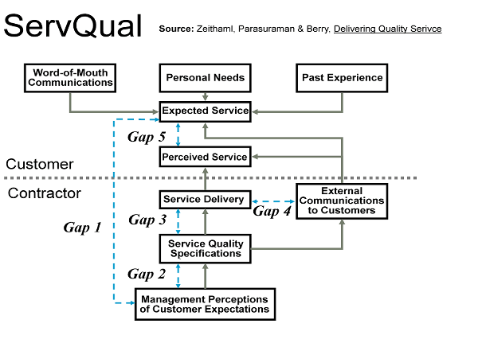
Service Quality Gaps
Achieving customer satisfaction
SERVQUAL model of service quality (Zeithaml et al., 1990)

Slide 13
Service Quality Gaps
Achieving customer satisfaction
SERVQUAL model of service quality (Zeithaml et al., 1990):
service quality gap – perception of service received is less than what is expected; five service dimensions:
Responsiveness – willingness to help customers;
Assurance – knowledge and courtesy of employees;
Tangibles – appearance of physical facilities;
Empathy – caring, individualised attention;
Reliability – ability to perform dependably;
possible service quality gaps:
gap 1: management does not know what guests expect;
gap 2: management is not willing or able to put the systems in place to match or exceed customer expectations;
gap 3: the service–performance gap – employees are unable and/or unwilling to perform the service at the desired level;
gap 4: promises do not match delivery.

Slide 14
Service Quality Gaps
How can gaps be closed?
Gaps may be positive or negative.
e.g. surpluses or deficiencies of a particular type of employee;
The strategy thus has to relieve labour surpluses or recruit additional labour.
Gaps may be closed by using the ‘five Rs’ individually or in combination. The five Rs are:
Retirement
Retraining
Redeployment
Redundancy
Recruitment.

Slide 15
Human Resource Audit
Can human resources implement strategy?
investigation into size, skills, structure and all other issues of those currently employed;
Assess the ability of human resources to implement a chosen strategy or range of strategic options.
typical audit checklist:
number of employees;
employee costs;
organisational structure;
recruitment and selection procedures;
quality and effectiveness of training and development;
employee motivation and morale;
quality of employee or industrial relations;
internal and external networks of employees;
effectiveness of human resource policies and control procedures.

Slide 16
Critical Success Factors
Some human resources may be critical
As well as identifying gaps, HR audit may establish which employees or groups are critical to strategic success.
Usually there are one or more reasons why some organisations have superior performers.
Key reasons for success are called Critical Success Factors (CSFs).
CSFs may lie in several areas – but often human resources often form a part.
e.g. some companies may have:
uniquely skilled employees;
employees with exceptional knowledge and experience;
an inspirational leader.

Slide 17
Organisational Culture
Is the culture – organisational equivalent of a human’s personality;
As with human personality, culture can be difficult to explain andf define. Consequently there are many definitions.
Culture can be explained in terms of the ‘feel’ of an organisation or its ‘character’ or ‘the way we do things round here’.
A strategically important point is that all organisations have a culture that it can have a significant effect on organisational performance.
THE managers:
must attempt to understand the culture;
and the effect it is has (positive or negative) on organisational performance;
Managers may subsequently need to take steps to implement a programme that attempts to change the prevailing culture to improve performance.

Slide 18
The Determinants of Culture
Many possible influences
philosophy of the organisation’s founders, especially if it is relatively young;
nature of activities and character of industry it competes in;
nature of the interpersonal relationships and the nature of industrial or employee relationships;
management style adopted and types of control mechanism, e.g. existent management style is autocratic or democratic;
national or regional character of areas where organisation’s activities are located. in turn, this can affect the power distance, which also influences culture;
structure of organisation, particularly its ‘height’ and ‘width’;
dependency on technology and the type of technology employed.

Slide 19
Importance of Culture
Culture can have broad influences
culture can have an influence on:
employee motivation;
attractiveness as an employer and hence the rate of staff turnover;
employee morale and ‘goodwill’;
productivity and efficiency;
quality of work;
nature of industrial relations;
attitude of employees in the workplace;
innovation and creativity;
Many THE organisations have recognised the importance of a strong and consistently applied culture.
can enable organisations to strive to deliver:
consistent standards of service;
can be used as a promotional tool externally and internally.

Slide 20
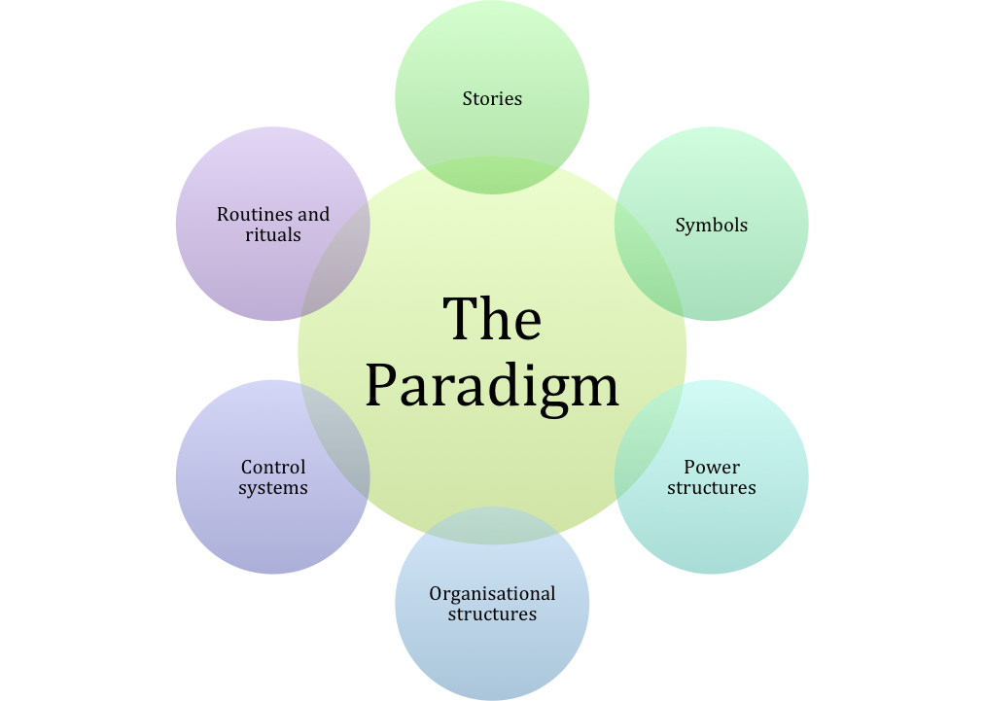
The Cultural Web

Slide 21
The Cultural Web
Elements of the web
stories – what people within the organisation talk to each other about;
routines and rituals – routines are procedures for doing things; rituals have longer time frame and can be either formal or informal;
symbols – aspects that symbolise something to some people;
structure – can mean more than just those formal relationships shown on an organisation diagram;
control systems – ways in which activities are controlled;
power structures – core assumptions that contribute to the paradigm are likely to be made by the most powerful management;
paradigm – the aggregate effects of the all of the cultural influences on the way the organisation looks at the world.

Slide 22
Hofstede’s Cross-Cultural Differences
Cultural dimensions theory
THE is, by its nature, international in orientation.
thus it is important that THE managers understand:
the influence of national culture;
the effects the differences have upon the successful implementation of strategy;
Hofstede’s cultural dimensions theory presents five dimensions:
Power distance
Individualism/collectivism
Masculinity versus femininity
Uncertainty avoidance
Long-termism versus short-termism.

Slide 23
SUMMARY
THE is often highly labour-intensive and human resources are often the key differentiator between organisations.
The THE workforce often has particular characteristics.
Front-line employees are vital in creating and maintaining service quality.
Service quality is linked to business success through the HR virtuous circle.
SERVQUAL – model of service quality;
HR audit allows gaps and CSFs to be identified.
Culture has an effect upon performance.

Slide 24
Tourism, Hospitality and Event Organisations The Operational Context: Competencies, Resources and Competitive Advantage

Slide 25
Introduction
In this session:
the sources of competitive advantage;
resource analysis;
competencies and core competencies;
analysis outcomes;
value adding activities;
the service profit chain;
the (pims) study;
service dominant logic.

Slide 26
Competitive Advantage
It is often seen as the overall purpose of strategy.
In commercial settings it is usually viewed as returning higher profits than competitors.
Higher profits allow more to be retained to reinvest in its strategy, thus maintaining a lead over competitors .
When the superiority is maintained over time, sustainable competitive advantage is achieved.
To be sustainable the advantage must be able to resist the actions of rivals.

Slide 27
Sources of Competitive Advantage
Why are some organisations more successful?
In strategy this is usually associated with achieving competitive advantage and faster growth than competitors.
Previously we stressed the importance of context, but other factors have to be considered in any context.

Slide 28
Sources of Competitive Advantage
How is competitive advantage achieved
The sources of achieving competitive advantage in any industry lie in:
the superior application of competencies (skills);
the deployment of superior resources (assets);
creating value for consumers.

Slide 29
Resource Analysis
Some resources are easier to analyse than others
Resources can be tangible or intangible.
tangible
obtained from outside organisations in resource markets in competition with others;
intangible
often developed within an organisation;
have a value (often difficult to quantify or even identify) which can be bought and sold in markets;
Relationships with resource suppliers can be a part of the organisation’s core competence.

Slide 30
Resources in THE
Are some resources free?
THE is different from most other industries in that free resources are often vital.
available freely with unlimited supply and not requiring a market to allocate them, e.g. air, sea and scenery;
have to be utilised carefully in a sustainable way;
All resources have competing demands.
If they are used in one way they cannot be used in another.

Slide 31
Resources in THE
Key resource considerations in THE
resource immobility;
Many resources that are used cannot be moved either in terms of place or time.
resource substitution;
often difficult to substitute one resource category with another;
resource conflict and competition;
often in conflict or competition with other users;
resource ownership and control;
utilise resources that are neither owned nor controlled.

Slide 32
Resources in THE
Some further considerations
seasonality of resource utilisation;
Many THE activities are highly seasonal.
low rewards for resources;
sometimes only able to offer relatively low rewards;
capacity;
resource capacity often constrained in some way;
time;
Consumers have to give up their scarce resource-time.

Slide 33
Analysing Resources
There are different ways:
analysis by category;
physical, operational, human, financial and intangible resources;
analysis by specificity;
Resources can be specific or non-specific.
analysis by performance;
How do they contribute to internal and external measures of performance?
Organisations can internally and externally benchmark performance as to stimulate improvements.

Slide 34
Competencies and Core Competencies
What are you good at?
Competencies;
Attributes such as skills, knowledge, technology and relationships that are common among competitors in an industry;
Core competencies are attributes distinguished from competencies.
Performance is superior to industry average.
unique to the company;
more complex;
difficult to emulate (copy);
relate to fulfilling specific customer needs;
add greater value than competencies;
distinctive relationships with customers, distributors and suppliers;
superior organisational skills and knowledge.

Slide 35
Analysis Outcomes
What does resource and competency analysis add to our understanding?
The aim of an analysis of resources, competencies and core competencies is to understand the:
nature of the resources on which the organisation depends;
nature and sources of particular core competencies;
need for adaptation of existing core competencies;
need for new core competence building;
potential sources of core competence based on resources and competencies;
need for core competencies to remain focused on customer needs.

Slide 36
Value
What is it and how can we add to it?
value – the difference in value of the product compared to the value of the inputs. It can be increased by:
charging customers a higher rate;
reducing costs below those of competitors;
clear links between value-adding activities, core competencies, competencies and resources;
resources form inputs to the value-adding activities;
Competencies and core competencies provide the attributes to carry out the value-adding activities.
Greater value will be added the more that core competencies can be added to activities.

Slide 37
Outsourcing
Used by many THE organisations
outsourcing – entrusting some of an organisation’s activities to an external entity;
Organisations concentrate on core activities associated with core competencies.
Activities which are not regarded as core are outsourced.
Combined complementary core competencies add to competitive advantage for all collaborators.
Value chain analysis can identify where outsourcing might add greater value.

Slide 38
Other Approaches
Other important contributions
the service profit chain emphasises:
the roles of employees internally to the organisation;
the way in which services are delivered;
targeting of marketing to customers’ needs;
the Profit Impact of Market Strategy (PIMS) study:
key finding: a primary determinant of profitability is market share;
service dominant logic focuses on:
intangible rather than tangible resources;
cocreation of value rather than embedded value;
relationships rather than transactions.

Slide 39
SUMMARY
THE organisations have to try to configure and coordinate their operational resources and processes in such a way that they add value.
In so doing they achieve an advantage over competitors – competitive advantage.
It is very important in the strategy to have a good understanding of the resources they have available to them and how these are used to create value.
Analysis indicates where strategy needs to focus.
It is also necessary to consider the potential for collaboration with suppliers, distributors and customers

