Slide 1
Lecture 4 Strategic Management THE

Slide 2
The Human Context and Culture

Slide 3
The Determinants of Culture
Many possible influences
philosophy of the organisation’s founders, especially if it is relatively young;
nature of activities and character of industry it competes in;
nature of the interpersonal relationships and the nature of industrial or employee relationships;
management style adopted and types of control mechanism, e.g. existent management style is autocratic or democratic;
national or regional character of areas where organisation’s activities are located. in turn, this can affect the power distance, which also influences culture;
structure of organisation, particularly its ‘height’ and ‘width’;
dependency on technology and the type of technology employed.

Slide 4
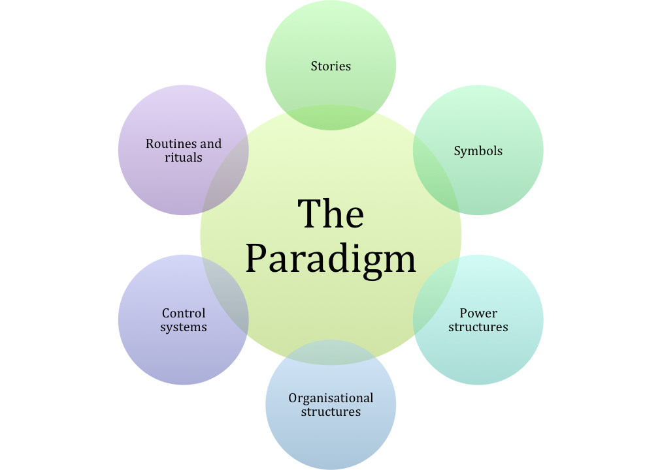
The Cultural Web

Slide 5
The Cultural Web
Elements of the web
stories – what people within the organisation talk to each other about;
routines and rituals – routines are procedures for doing things; rituals have longer time frame and can be either formal or informal;
symbols – aspects that symbolise something to some people;
structure – can mean more than just those formal relationships shown on an organisation diagram;
control systems – ways in which activities are controlled;
power structures – core assumptions that contribute to the paradigm are likely to be made by the most powerful management;
paradigm – the aggregate effects of the all of the cultural influences on the way the organisation looks at the world.

Slide 6
Hofstede’s Cross-Cultural Differences
Cultural dimensions theory
THE is, by its nature, international in orientation.
thus it is important that THE managers understand:
the influence of national culture;
the effects the differences have upon the successful implementation of strategy;
Hofstede’s cultural dimensions theory presents five dimensions:
Power distance
Individualism/collectivism
Masculinity versus femininity
Uncertainty avoidance
Long-termism versus short-termism.

Slide 7
Tourism, Hospitality and Event Organisations The Operational Context: Competencies, Resources and Competitive Advantage

Slide 8
Competitive Advantage
It is traditionally often seen as the overall purpose of strategy, but recently often critizised.
In commercial settings it is usually viewed as returning higher profits than competitors.
Higher profits allow more to be retained to reinvest in its strategy, thus maintaining a lead over competitors .
When the superiority is maintained over time, sustainable competitive advantage is achieved.
To be sustainable the advantage must be able to resist the actions of rivals.

Slide 9
Sources of Competitive Advantage
Why are some organisations more successful?
In strategy this is usually associated with achieving competitive advantage and faster growth than competitors.
Previously we stressed the importance of context, but other factors have to be considered in any context.

Slide 10
Sources of Competitive Advantage
How is competitive advantage achieved
The sources of achieving competitive advantage in any industry lie in:
the superior application of competencies (skills);
the deployment of superior resources (assets);
creating value for consumers.

Slide 11
Resource Analysis
Some resources are easier to analyse than others
Resources can be tangible or intangible.
tangible
obtained from outside organisations in resource markets in competition with others;
intangible
often developed within an organisation;
have a value (often difficult to quantify or even identify) which can be bought and sold in markets;
Relationships with resource suppliers can be a part of the organisation’s core competence.

Slide 12
Resources in THE
Are some resources free?
THE is different from most other industries in that free resources are often vital.
available freely with unlimited supply and not requiring a market to allocate them, e.g. air, sea and scenery;
have to be utilised carefully in a sustainable way;
All resources have competing demands.
If they are used in one way they cannot be used in another.

Slide 13
Resources in THE
Key resource considerations in THE
resource immobility;
Many resources that are used cannot be moved either in terms of place or time.
resource substitution;
often difficult to substitute one resource category with another;
resource conflict and competition;
often in conflict or competition with other users;
resource ownership and control;
utilise resources that are neither owned nor controlled.

Slide 14
Resources in THE
Some further considerations
seasonality of resource utilisation;
Many THE activities are highly seasonal.
low rewards for resources;
sometimes only able to offer relatively low rewards;
capacity;
resource capacity often constrained in some way;
time;
Consumers have to give up their scarce resource-time.

Slide 15
Outsourcing
Used by many THE organisations
outsourcing – entrusting some of an organisation’s activities to an external entity;
Organisations concentrate on core activities associated with core competencies.
Activities which are not regarded as core are outsourced.
Combined complementary core competencies add to competitive advantage for all collaborators.
Value chain analysis can identify where outsourcing might add greater value.

Slide 16
Tourism, Hospitality and Event Organisations The Products and Markets Context

Slide 17
Introduction
Strategic marketing
the way an organisation’s products relate to its markets:
one of the most important aspects of competitive strategy;
Marketing and strategy literature are closely related and often refer to product/market strategy.
an organisation may have great technical and operational capabilities but:
these only become a source of competitive advantage when such ‘distinctive capabilities’ are applied in the marketplace (Kay, 1995);
Hence it is critical that THE managers define and understand the markets they are operating in.

Slide 18
Understanding Markets
A key aspect of strategy
definition and boundaries of an organisation’s markets:
a key starting point for the formulation of strategy;
provide a basis for measuring competitive performance;
provides information on threats and opportunities facing an organisation;
important distinction between economics and strategy:
economics – Economists refer to a market as a system of two ‘sides’. The demand side comprises buyers and the supply side produces or operates products and services.
strategy – Here the market usually means a group of actual or potential customers with similar needs or wants (the demand side) and the supply side is usually viewed as an industry.

Slide 19
Market Attractiveness
Why sell in a particular market?
Managers often consider the attractiveness of a market.
will a particular market deliver returns on investment that are attractive?
Various factors contribute to market attractiveness.
market size – Generally larger markets are more attractive,
e.g. mass holidays to Spain from northern Europe.
market growth rate – Growing markets are normally more attractive than static or declining markets,
e.g. the market for fast travel between China’s major cities.
supplier concentration – The extent to which a market is dominated by its largest suppliers. Large organisations, which dominate the market, will tend to have advantages,
e.g. the hotels sector has traditionally been highly fragmented but concentration has been increasing.

Slide 20
Defining Markets
Not as easy as it seems
Boundaries of markets are defined in different ways.
If organisations define a market in different ways it’s not surprising that market share claims may not total 100%.
Services are particularly difficult because boundaries between them often overlap and are difficult to define.
whereas the market for many manufactured products such as cars is obvious.
Particularly acute problems in THE sectors:
Terminology is often used interchangeably.
Boundaries are often vague or overlapping.
Organisations, regions and countries use different definitions.

Slide 21
Defining Markets
Bases for defining markets
three ways markets are commonly defined:
based on product;
based on need satisfaction or function performed;
based on customer identity;
All the ways listed have certain advantages and disadvantages and may be used for different purposes.
In practice, most businesses serve several markets.
Markets will be defined combining the ways listed.
A key strategic task for managers is to produce combinations that gain benefits and enable opportunities to be exploited.
For achieving competitive success a key concept is the served market.
i.e. the specific part of a market that the company is trading in;
It will provide the most meaningful measure of market share.

Slide 22
STP Marketing
Focusing marketing efforts
Philip Kotler (and others) advocate STP or targeted marketing as the essence of strategic marketing.
Segmenting
Targeting
Positioning
focusing marketing efforts on those customers that the organisation has the greatest chance of satisfying;
underpinning this strategic process:
need to understand the process by which potential purchasers decide to buy, i.e. buyer behaviour;
This requires knowledge of the structure of the market and competitive products provided by marketing research.

Slide 23
Criteria for Segmentation
Different ways to segment a market
Consider the bases or variables for segmenting.
Distinction is often made between two groups of variables.
socio-demographic, geographic and psychographic variables – based on consumer characteristics;
behaviouristic variables – based on consumer responses;
In most cases actual segments chosen represent a combination of bases sometimes called matrix segmentation.
Socio-demographic segmentation addresses the question who buys?
Geographic and variant geodemographic segmentation address the question where do they buy?
psychographic segmentation – consumers divided into groups on basis of social class, lifestyle and/or personality;
Behavioural segmentation – buyers divided into groups based on knowledge, attitude, use, or response to a product.

Slide 24
Business to Business (B2B) Marketing
Marketing to other businesses
THE organisations often market not to consumers but to other businesses – B2B marketing.
B2B consumers differ in needs, resources and buying habits.
B2B marketers typically segment by:
macro segmentation – focuses on the characteristics of the buying organisation;
micro segmentation – focuses on characteristics of decision making within the macro-segment, e.g. buying decision criteria;
reverse segmentation – Customers select suppliers that meet particular specified criteria, e.g. quality and price.
A supplier able to exhibit appropriate reverse segmentation criteria is more attractive to buyers.
partly because they demonstrate greater understanding of customer needs.

Slide 25
Targeting
Choose most attractive segments
When the possible range of segments has been identified, THE organisations then decide which segments to target.
Each segment should reflect a number of important characteristics.
market size and market growth – Each segment should be large enough, or demonstrate growth potential.
accessibility – Each segment should be capable of being reached, i.e. reachable.
measurability – Each segment should be measurable.
actionability – Each segment should capable of being actionable.

Slide 26
Positioning
Perceived product attributes
product positioning is the way in which a product or a brand is perceived in relation to:
the preferences of identified segments;
competitors’ products;
The perceptual image a consumer holds of an organisation or product is important.
A positive image can lead to the consumer purchasing products.
A negative image results in consumers looking elsewhere.
THE strategists and marketers must try to match:
the attributes of their product and buyers’ perceptions of those attributes; with the
needs and priorities of customers in that segment.

Slide 27
The Services Marketing Mix
Detailed decisions

Slide 28
Defining and Understanding Products
Differing perspectives
product – anything that can be offered to a market for that might satisfy a want or a need;
THE products – include all elements of the experience;
consider how product features might be enhanced;
in a way that is valued by customers;
To do this products can be considered at a number of levels.
core product –main benefit which the customers gain;
generic product – basic version of the product;
expected product – a set of attributes buyers normally expect;
augmented product – goes beyond customers’ expectations;
potential product – includes all enhancements the product might ultimately undergo.

Slide 29
The Product Life Cycle (PLC)
Widely used model
four phase model:
introductory – sales low as demand increases;
growth – increasing penetration of product and repeat sales lead to sales growth;
maturity – rate of growth slows and levels off;
decline – new more innovative products reach the market and decline sets in;
usefulness:
can be applied to most products;
gives insights into behaviour of products;
simple, easily understood and widely used;
important strategic implications.

Slide 30
PLC
Strategic implications
focuses management attention on likely future sales pattern if no action taken;
Strategic action can extend length of the cycle and show need for new products.
strategic implications:
Phase | Strategic focus | Cash flow
Introduction | Expand market | Negative
Growth | Market penetration | Moderate
Maturity | Defend share | High
Decline | Productivity | Low

Slide 31
New Product Development
PLC can help identify need for new products
Most organisations need to innovate regarding products.
New products can provide further growth.
totally new products are rare, though they:
may be labelled as ‘new’;
promoted as ‘new’ but from existing products;
are ‘new’ to a particular market segment;
New products are expensive to develop and risks of failure are high.
Products can be generated from many sources.
a screening process attempts to avoid wasted errors:
GO errors – products are developed that ultimately fail;
DROP errors – ideas are abandoned that would have succeeded.

Slide 32
Product Portfolio Theory Balancing risks and opportunities
A broad portfolio signifies that a business has a presence in a wide range of product and market sectors.
advantage – a downturn in one market will not threaten whole company;
But it is necessary to manage business interests that may be diverse.
company may be said to lack strategic focus;
developed partly due to dissatisfaction with PLC in 1970s:
company’s products at different stages of development;
company should balance sales growth and cash flow in order to manage its level of risk;
develop a portfolio of products which will change over time;
best known – Boston Consultancy Group Matrix (BCG).

Slide 33
BCG
BCG Matrix – key assumptions
Cash generation/usage is key to developing balanced product portfolio.
cash generated depends upon:
relative market share;
market growth;
BCG is a simplifying tool.
relative market share indicates strength of SBU competitive position;
growth indicates potential and attractiveness of market;
BCG can be used in forecasting.

Slide 34
The Experience Effect
Underpins the BCG Matrix
Also implicit in the matrix are the benefits to be gained from the experience effect.
High market share and greater experience
Higher profits
Greater spending on R D and marketing
Lower costs

Slide 35
BCG Matrix

Slide 36
BCG Matrix
Strategic implications
Business category | Market share thrust | Business profitability | Investment required | Net cash flow
Stars | Hold/increase | High | High | Around zero or slightly negative
Cash cows | Hold | High | Low | Highly positive
Question marks A | Increase | None or negative | Very high | Highly negative
Question marks B | Harvest/divest | Low or negative | Divest | Positive
Dogs | Harvest/divest | Low or negative | Divest | Positive

