Slide 1
Chinese Hospitality Investors keeping pace with the
Second Wave of China’s
Outbound Tourism
Tag der Hotelimmobilie, Berlin Adlon Hotel
November 11, 2015
Prof. Dr. Wolfgang Georg Arlt FRGS

Slide 2
Why we are talking
about China

Slide 3
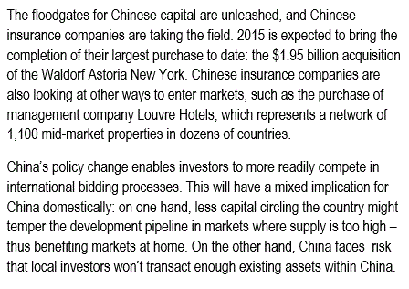

Slide 4
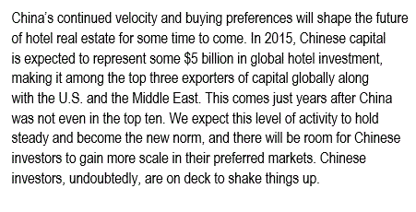

Slide 5
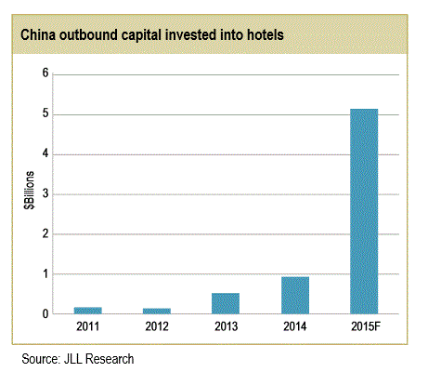

Slide 6
Relevance of outbound travel
for Chinese tourism industry by number of travellers

Slide 7
Relevance of outbound travel
for Chinese tourism industry
by spending

Slide 8
Chinese Outbound Hospitality Investment in Europe
First Wave (1990s – 2013)
Chinese tour operators extend value chain by buying / building 2-3 Star hotels in Europe mostly for Chinese travel groups in key destinations (Venice, Paris, Frankfurt, Brussels…)
With growing travel and tourism development in China growth of major international and domestic hotel groups within China
With growing support of Outbound FDI by Chinese government and opening of foreign service industry investment to wider range of Chinese companies including insurance companies, retail companies etc. now paradigm change

Slide 9
Chinese Outbound Hospitality Investment in Europe
Second Wave (2014ff.)
New paradigm: Strategic investment of major players in hotel chains to catch international market, not concentrating on Chinese outbound tourism anymore:
Examples Club Med, Louvre Group, Starwood (?)
Including trophy properties: Example Waldorf Astoria NYC
Development belated in comparison to Chinese OFDI in other areas (Volvo, Putzmeister, House of Fraser, “Sri Lanka”)

Slide 10
Chinese Outbound Hospitality Investment in Europe
Second Wave (2014ff.)
Player in second wave include many of most important Chinese companies and the China Investment Corporation:
Dalian Wanda (the „Disney“ of China) Alibaba (the Ebay+Amazon+VISA of China) Jinjiang Hotel Group (aims to become global No. 1) HNA Hainan Airline Group (early starter) Ctrip (more than 50% market share of OTA market) CIC (government investment fund)
Anbang Insurance Group (buyer of Waldorf Astoria)

Slide 11
Outlook Chinese Outbound
Tourism
Second Wave travellers more open to suggestions, but also more confident and demanding than ever
Second Wave Chinese travellers can be attracted to new products, new places, new activities, new times of the year, bringing not only more, but a different kind of business
But: To satisfy the Second Wave Chinese travellers needs more preparation and understanding to keep the balance between treating Chinese Second Wave customers as international citizens and still showing respect to the Chinese culture by providing the right kind of reasons to come, the right story to tell and providing the feeling of being more welcomed as Second Wave Chinese traveller than any other kind of customer

Slide 12
Outlook Chinese Hospitality
Investment
Second Wave investment will continue to grow
Investment in tangible assets is still preferred by most Chinese investors
Further growth of tourism in Europe in coming decades is taken for granted, investment in hospitality property at current prices appears to Chinese investors as a safe bet compared to stocks, art, IT companies
Chinese outbound travellers are seen as a part of the market (itineraries for package tours can be adapted to include less central locations) but are no longer the main focus of investors
China is No. 1 in many fields (beer production, hi-speed train network, internet users…), Chinese investors aim to develop the largest hotel chains in the world

